Slide 1
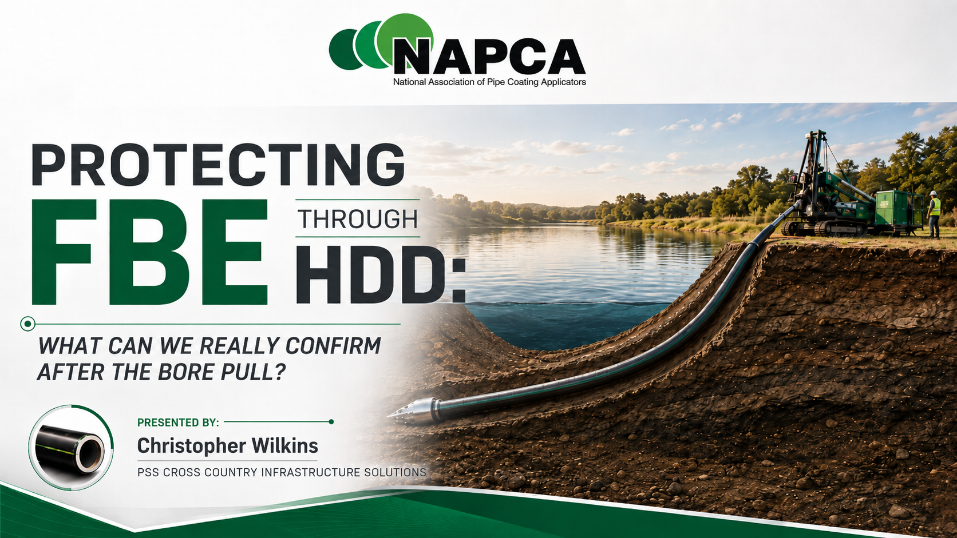
Notes:
This presentation focuses on a central question: after an FBE-coated pipeline is installed through an HDD crossing, what can we actually confirm about the condition of the coating?
FBE is the primary external corrosion barrier. Before installation, it can be inspected and tested directly. Once the pipe enters the bore, the coating is exposed to mechanical forces that cannot be directly observed.
The purpose of this presentation is not to question the value of post-installation assessment tools. It is to distinguish between the information those tools provide and direct confirmation of the physical condition of the FBE.

Slide 2
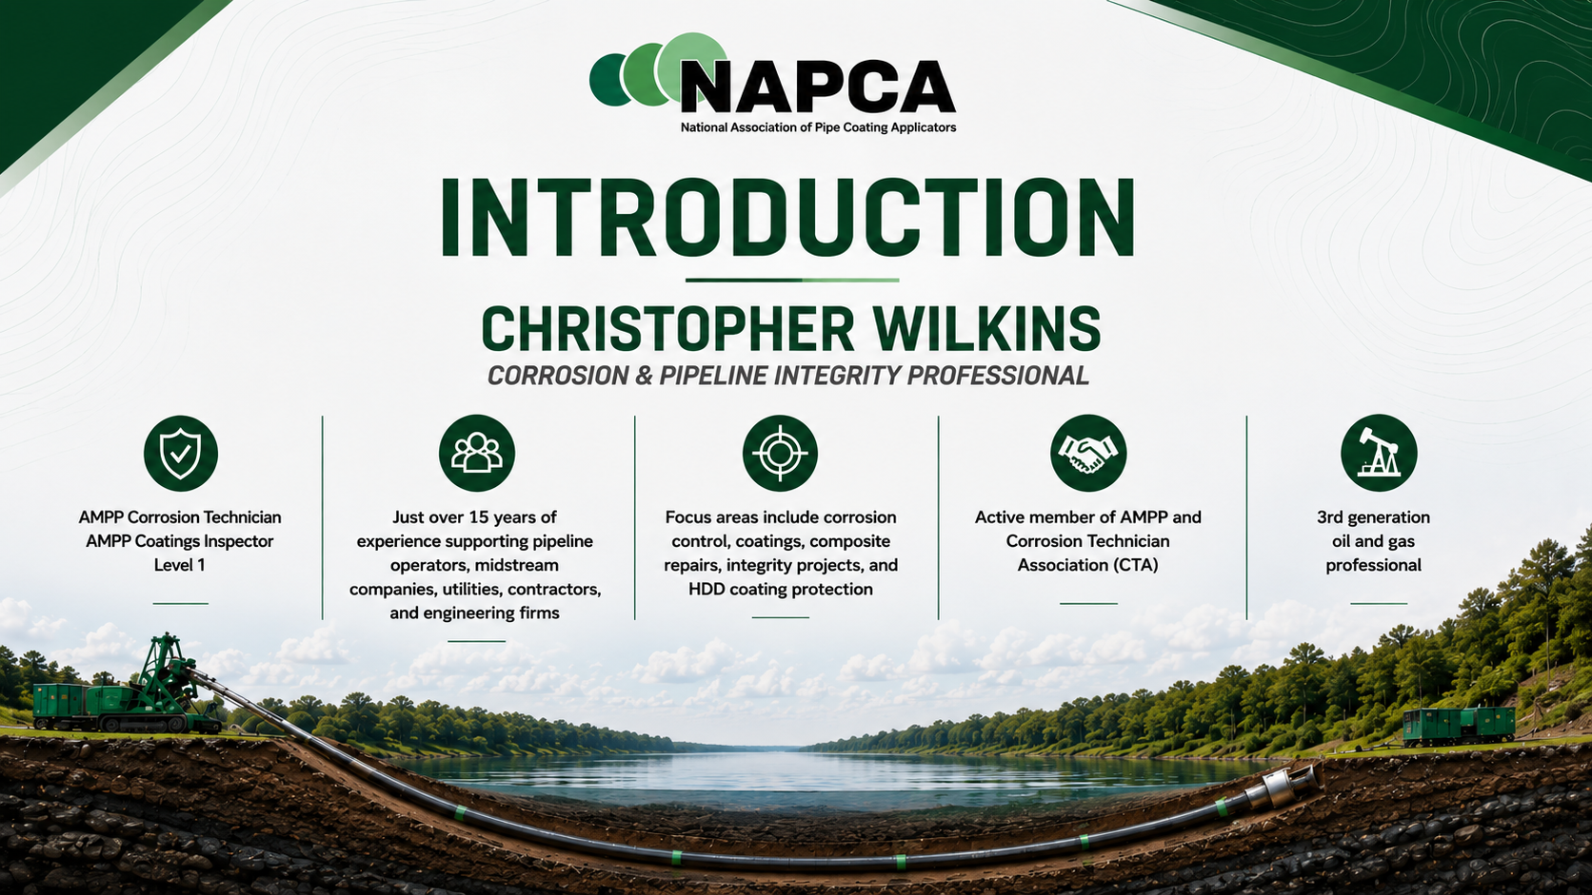
Notes:
The presentation follows the pipe through the HDD process.
We will review:
The FBE coating we are protecting
Mechanical risks during HDD installation
Abrasion-resistant protection options
How those protection systems are tested
Post-installation assessment methods
The difference between indirect information and direct confirmation
The industry-recognized verification challenge
Protection strategies for managing that uncertainty
The goal is to determine how limited post-installation verification should influence decisions made before the bore pull.

Slide 3
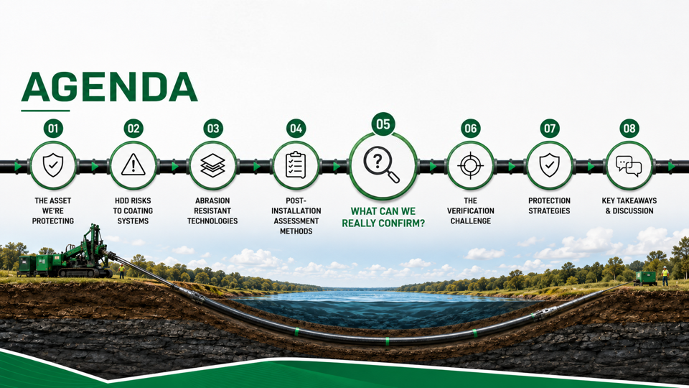

Slide 4
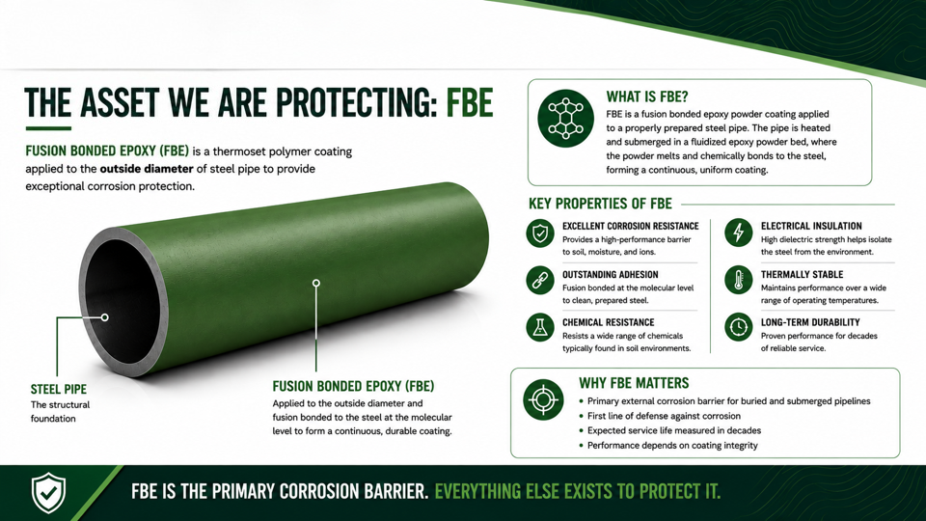
Notes:
For this audience, the purpose of this slide is not to explain FBE fundamentals.
The important point is the role FBE plays in the coating system.
The steel provides the structural pipe, while the FBE serves as the primary external corrosion barrier.
Abrasion-resistant overcoats, outer wraps, or combinations of the two are intended to help protect that underlying FBE during installation.
The key question is not simply whether the pipe successfully completes the bore pull. The question is whether the condition of the primary corrosion barrier can be confirmed afterward.

Slide 5
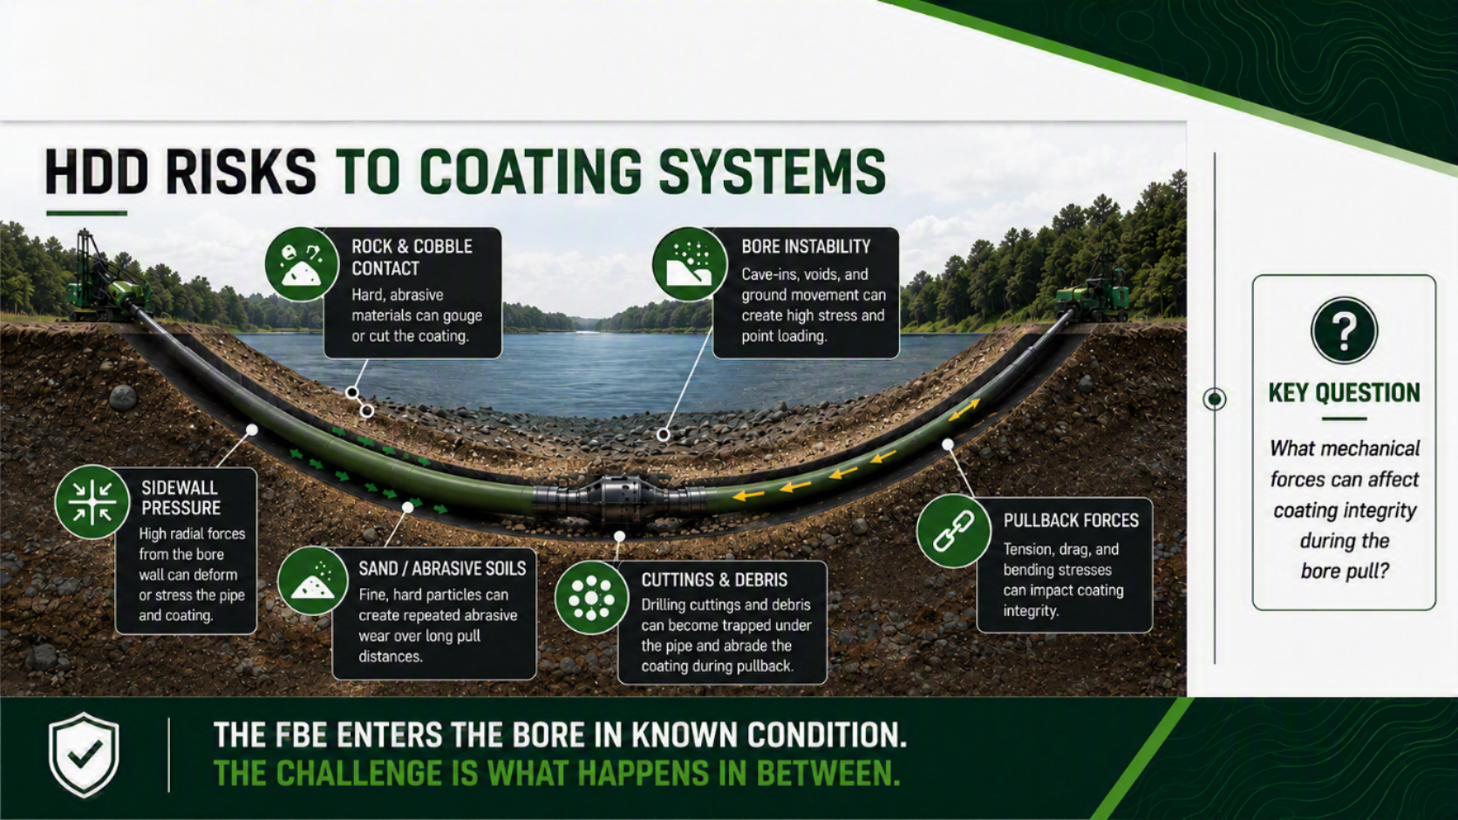
Notes:
During HDD installation, the coating may be exposed to several mechanical threats.
These can include:
Rock and cobble contact
Sidewall loading
Cuttings and debris
Bore instability or movement
Pullback tension, drag, and bending
The important issue is that these forces generally act on the coating while the pipe is inside the bore and cannot be directly observed.
The coating enters the bore in a known condition, but what occurs between entry and exit is much more difficult to verify.

Slide 6
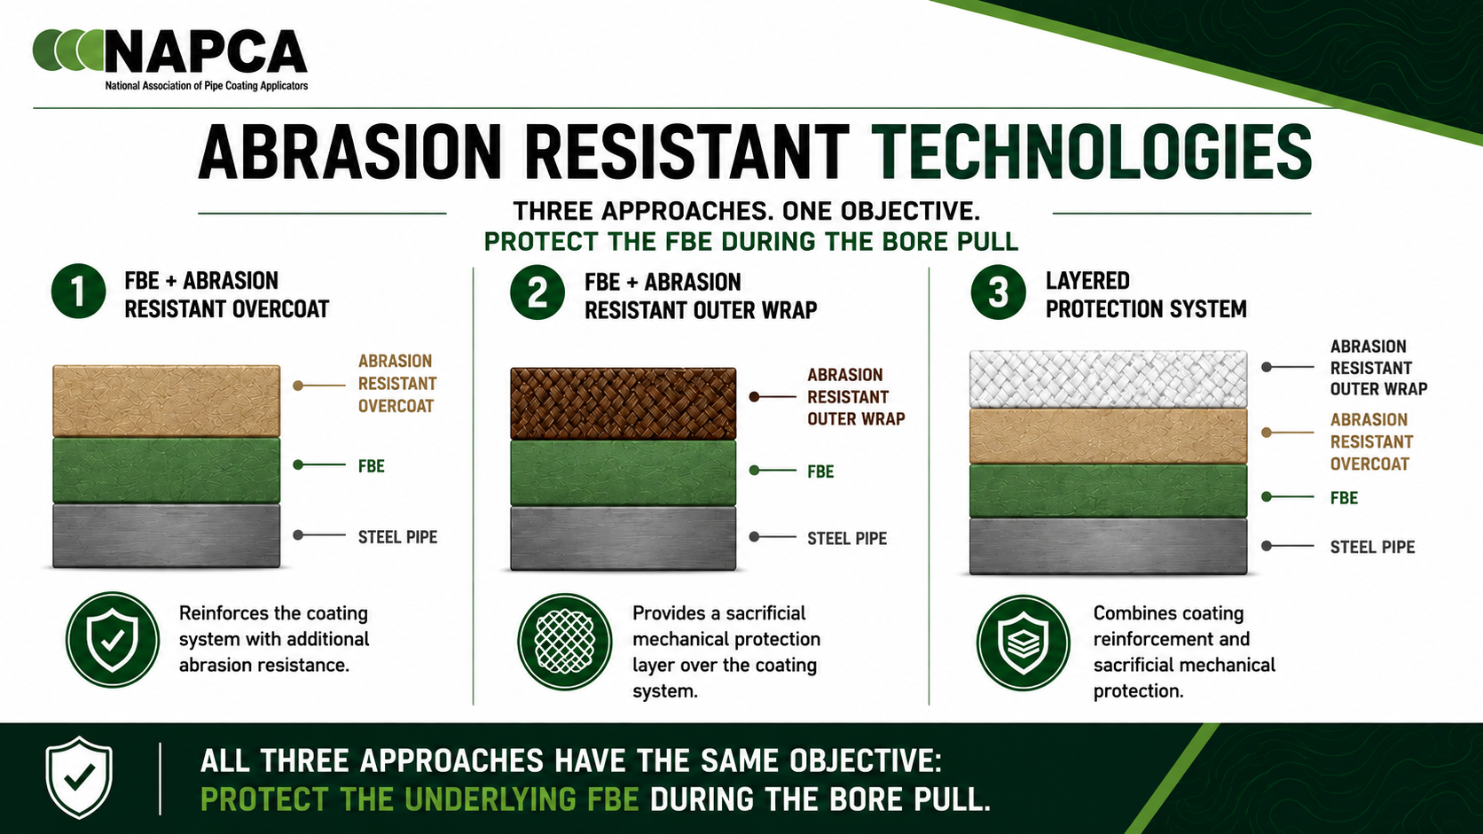
Notes:
There are three basic protection approaches shown on this slide.
The first is FBE with an abrasion-resistant overcoat.
The second is FBE with an abrasion-resistant outer wrap.
The third combines the overcoat and outer wrap into a layered protection system.
Both the overcoat and outer wrap are sacrificial layers intended to help protect the FBE from wear and mechanical damage.
These approaches can be used separately or together depending on bore conditions and project risk.
The objective is the same: prevent the bore environment from damaging the underlying FBE.

Slide 7
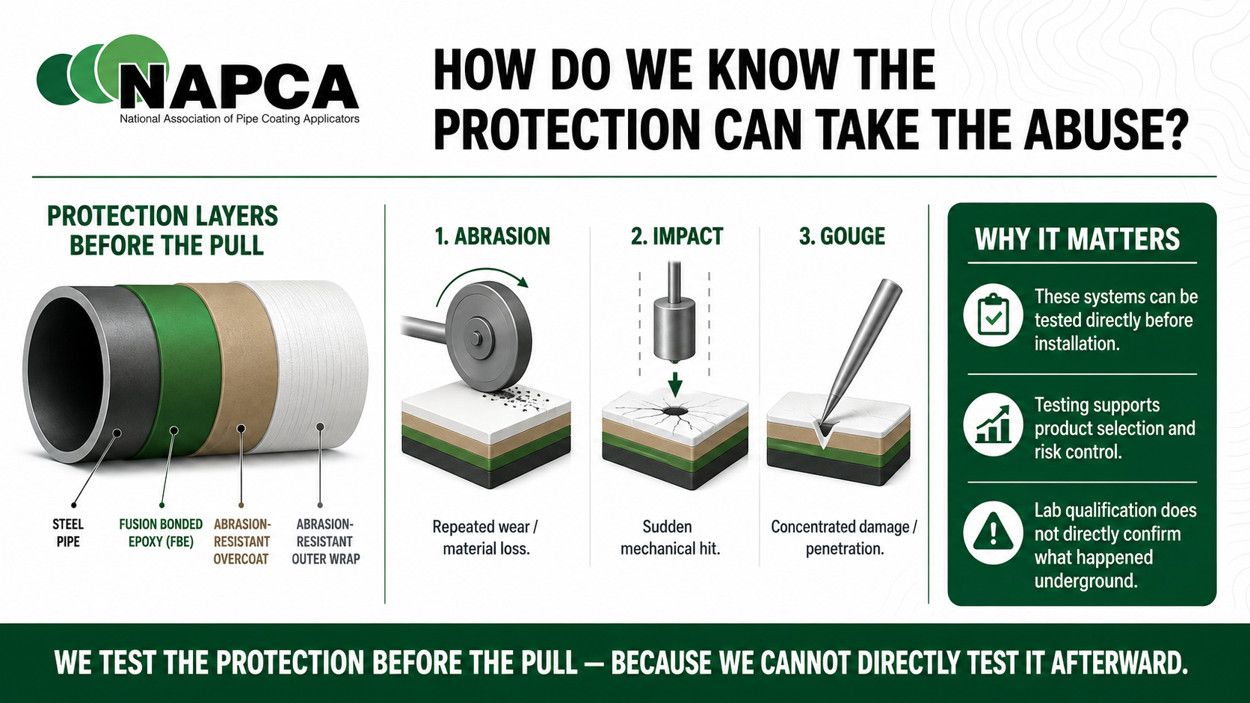
Notes:
Manufacturers test abrasion-resistant protection systems before installation to evaluate how they perform under mechanical loading.
Typical testing may include:
Abrasion or repeated wear
Impact resistance
Gouge resistance
Adhesion
Flexibility
Hardness
Cathodic disbondment
These tests allow products and systems to be directly evaluated and compared before installation.
Qualification testing provides information about what a protection system is designed to withstand.
However, laboratory qualification does not tell us exactly what happened to a specific coating system during a specific HDD pull.
That distinction becomes important once the pipe is underground.

Slide 8
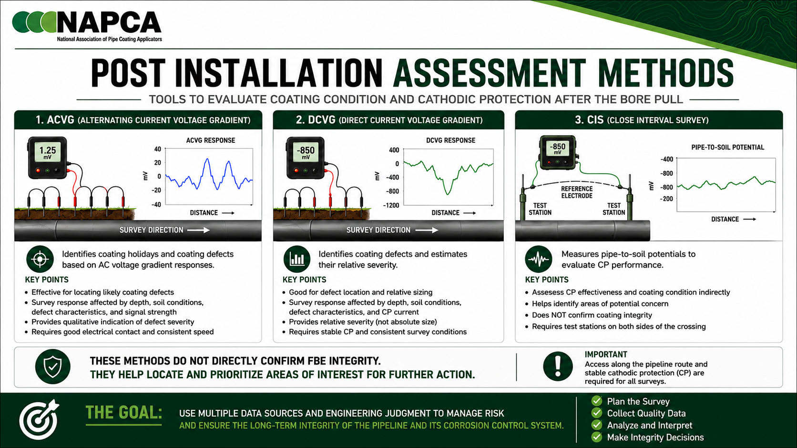
Notes:
Three commonly used post-installation assessment methods are ACVG, DCVG, and CIS.
ACVG can help identify likely coating defects based on AC voltage gradients.
DCVG can help locate coating defects and evaluate the strength or relative severity of an indication.
CIS provides pipe-to-soil potential data and helps evaluate cathodic protection performance.
Cathodic protection is intended to protect exposed steel where there is an electrical path through the coating system.
If CP is protecting exposed steel, that is important information. However, CIS alone does not identify exactly where the coating damage is, what the damage looks like, or whether the HDD installation caused it.
These are valuable tools, but they do not directly show the physical condition of the buried FBE.

Slide 9
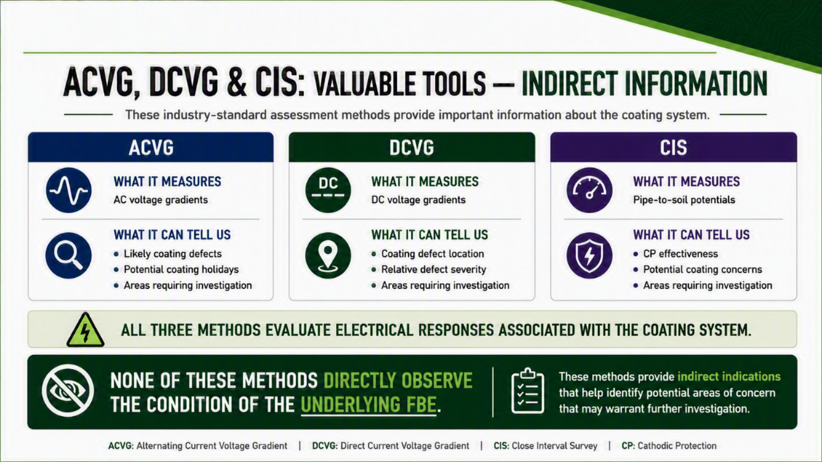
Notes:
ACVG, DCVG, and CIS provide important integrity information, but the information is indirect.
The methods measure electrical responses or pipe-to-soil potentials and use those measurements to identify areas of potential concern.
With many HDD crossings, directly exposing the pipe afterward is not practical.
The crossing may be beneath a river, lake, highway, structure, or other feature that the HDD was specifically designed to avoid disturbing.
As a result, post-installation assessment normally relies on measured responses rather than direct inspection of the coating.
Indirect information is valuable, but it should not be confused with direct physical confirmation.

Slide 10
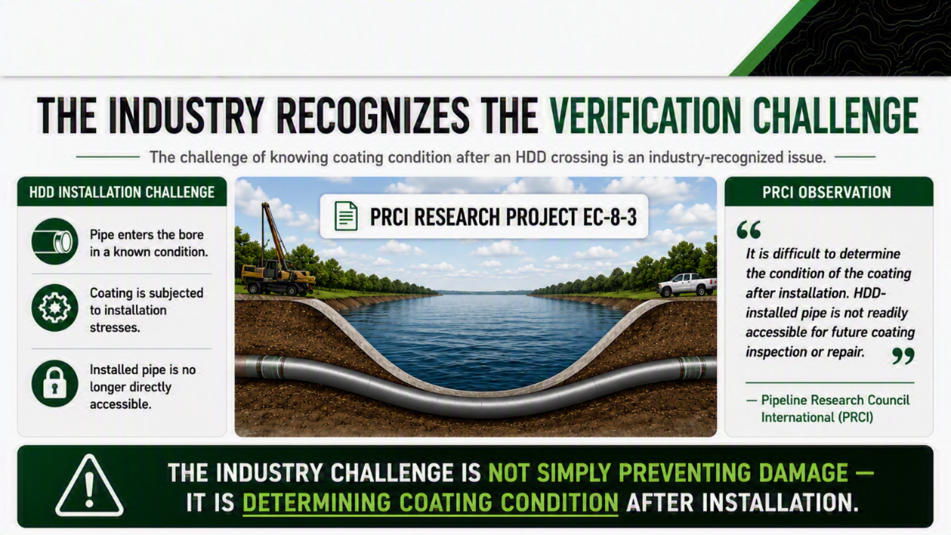
Notes:
The difficulty of determining coating condition after HDD installation is an industry-recognized issue.
The pipe enters the bore in a known condition, experiences installation stresses during the pull, and then becomes difficult to access once installed.
PRCI research has recognized that HDD-installed pipe is not readily accessible for future coating inspection or repair.
Preventing coating damage and proving that no coating damage occurred are two different things.
The lack of physical access after installation creates the verification challenge addressed throughout this presentation.

Slide 11
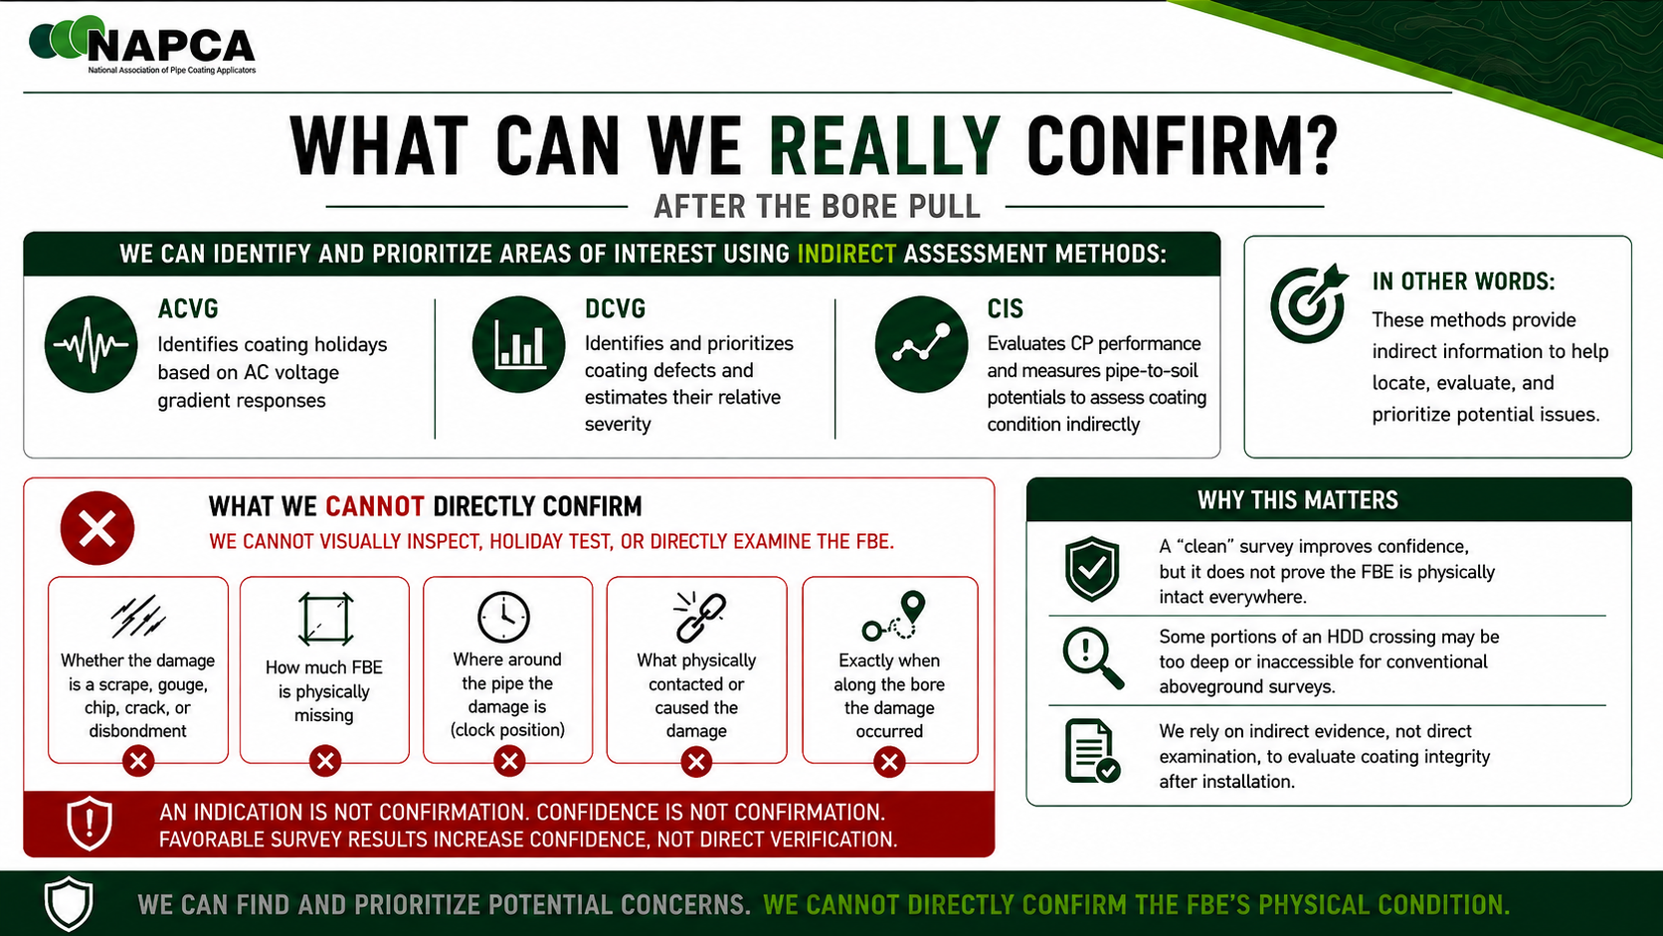
Notes:
After installation, direct access to the buried FBE is limited.
Without excavation, we generally cannot:
Visually inspect the coating
Perform direct holiday testing on the inaccessible section
Physically examine the coating surface
ACVG, DCVG, and CIS can provide useful information, identify indications, and help build confidence in coating and CP performance.
However, an indication is not the same as confirmation, and confidence is not the same as direct confirmation.
A favorable post-installation assessment does not mean the FBE has been physically confirmed to be in the exact same condition it was in before the pull.

Slide 12
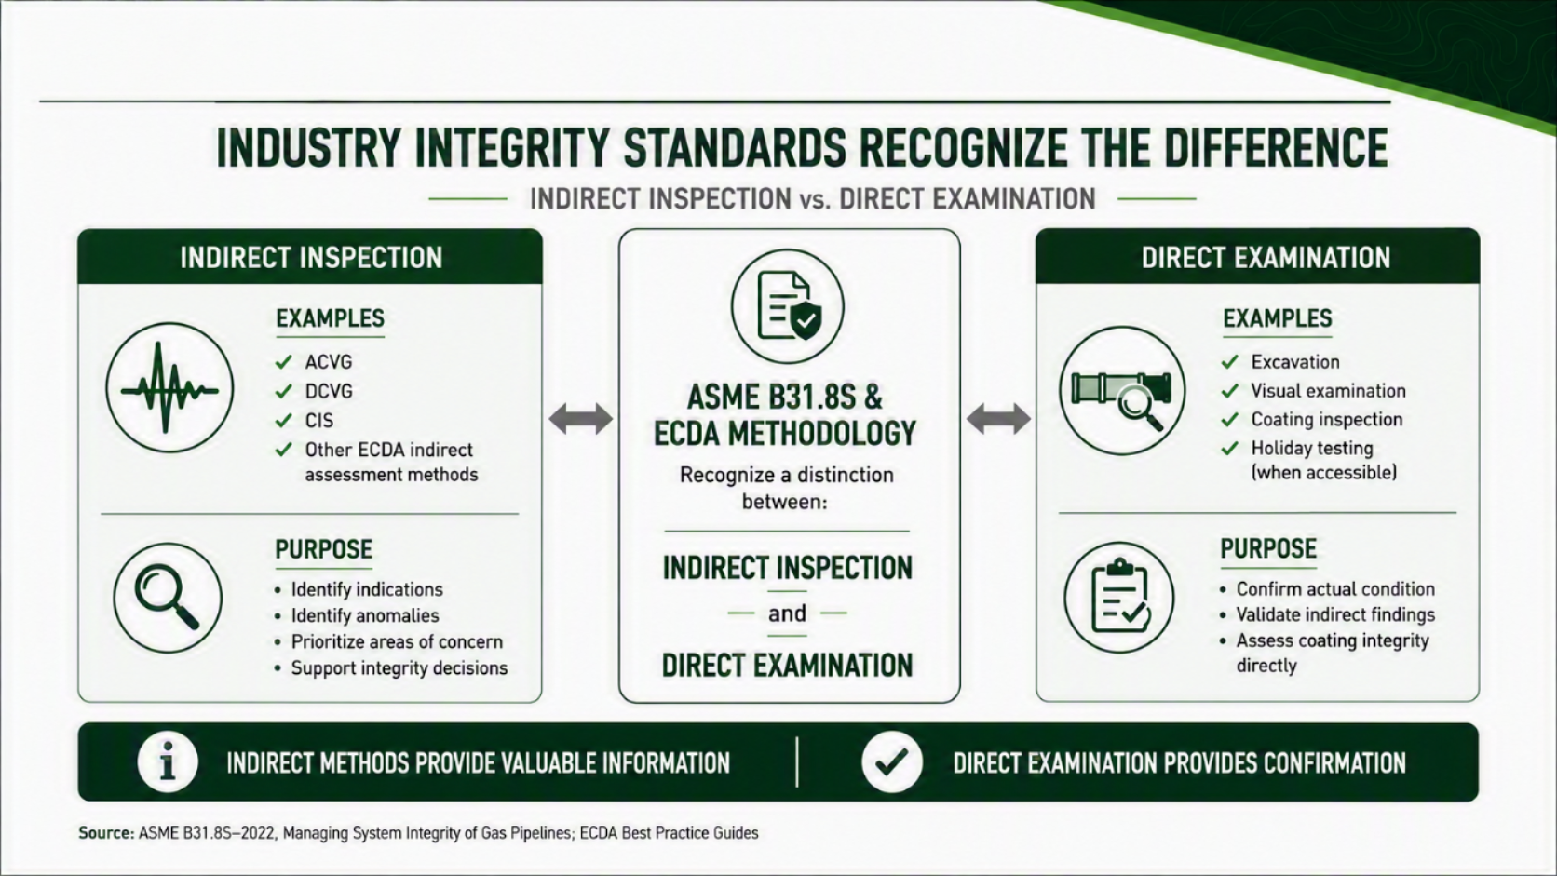
Notes:
Integrity programs distinguish between indirect inspection and direct examination.
Indirect inspection methods are used to identify indications, anomalies, and areas that may require further evaluation.
Direct examination requires physical access to the pipe and may include excavation, visual examination, coating inspection, and holiday testing.
Indirect inspection provides information and indications.
Direct examination allows the physical condition of the asset to be confirmed.
This distinction is important for HDD crossings because direct access to the installed pipe may be extremely difficult.

Slide 13
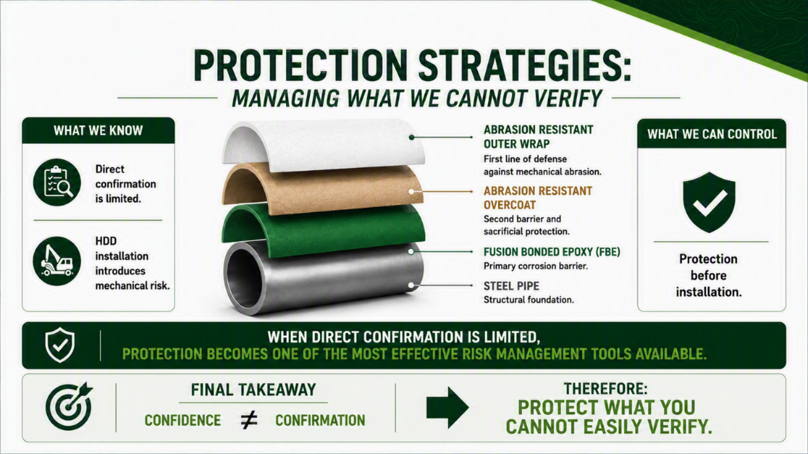
Notes:
If direct post-installation confirmation is limited, more attention should be given to controlling risk before installation.
The level of protection should be based on factors such as:
Bore conditions
Rock and soil conditions
Crossing length
Expected mechanical loading
Asset criticality
Consequence and cost of damage
An abrasion-resistant overcoat, an outer wrap, or a combination of both may be appropriate depending on the project.
Each sacrificial layer placed between the bore and the FBE provides another layer that can absorb wear before mechanical damage reaches the primary corrosion barrier.
The objective is not to eliminate all uncertainty. It is to reduce the likelihood of coating damage before the pipe becomes difficult to inspect directly.

Slide 14
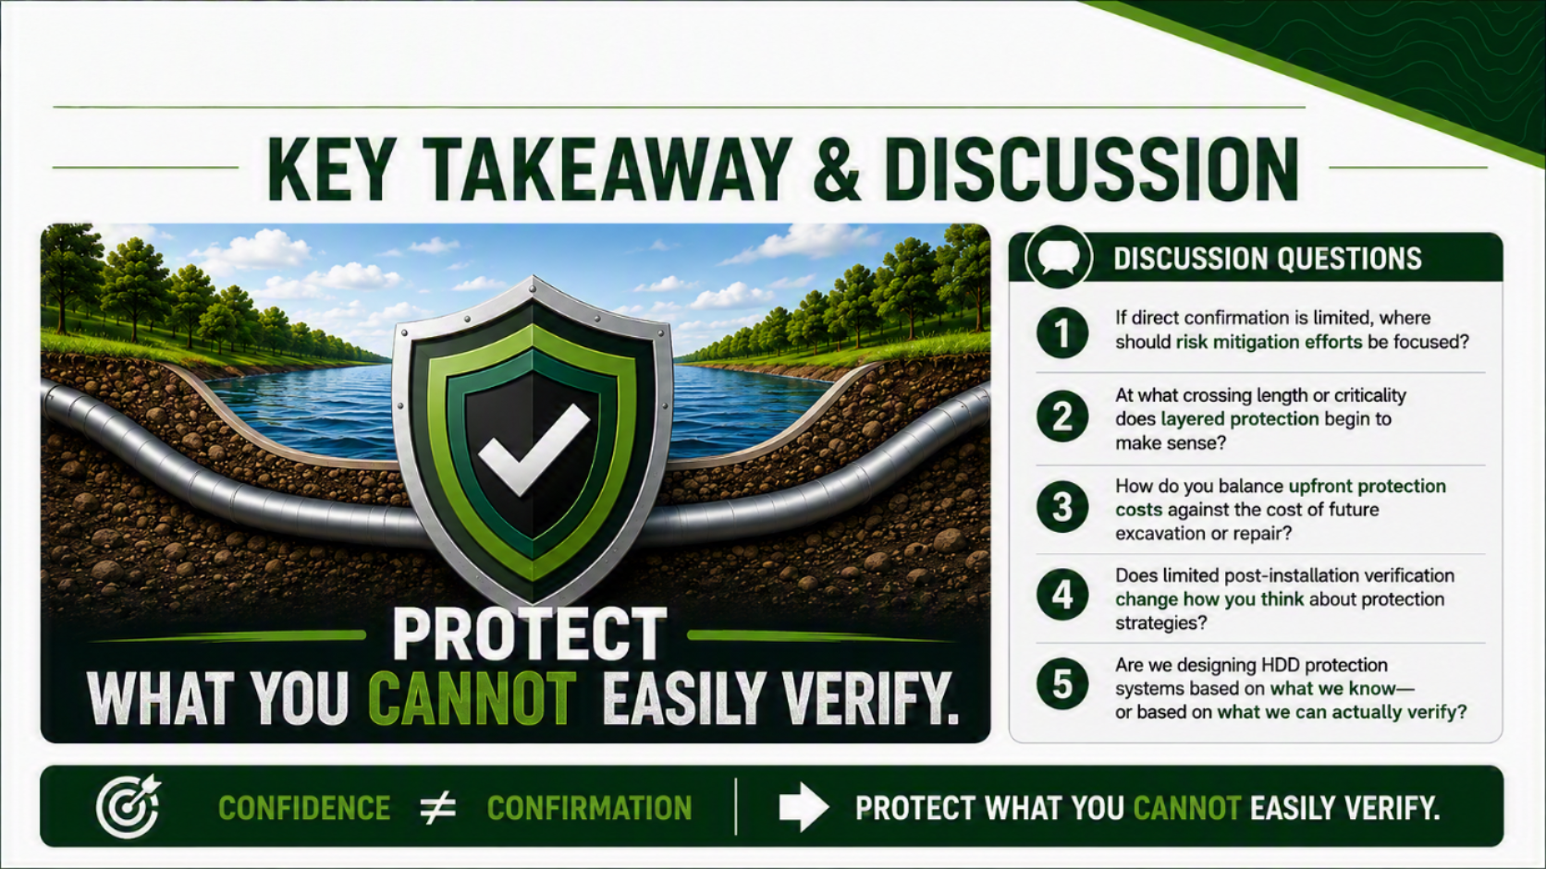
Notes:
The practical question is how limited post-installation verification should influence HDD design and protection decisions.
Consider:
When does a crossing justify additional protection?
Should length, geology, pull forces, criticality, or consequence drive that decision?
How should the cost of added protection be compared with the potential cost of future excavation or repair?
When does layered protection become appropriate?
The broader question is whether HDD coating protection should be designed around what we expect happened during the pull or around what we will actually be able to verify afterward.

Slide 15

Notes:
The main message of the presentation is:
Confidence is valuable. Confirmation is better.
When direct confirmation is limited, protecting the coating before installation becomes an important part of risk management.
The more effectively the FBE is protected before entering the bore, the less reliance must be placed on trying to determine its exact physical condition after it becomes inaccessible.
Protect what you cannot easily verify.

Slide 16



Notes:
Invite questions and discussion regarding:
HDD coating protection
Abrasion-resistant overcoats
Abrasion-resistant outer wraps
Layered protection systems
Post-installation assessment
The distinction between indirect information and direct confirmation
This slide can remain displayed during the Q&A session.

