Slide 1
Part 1
Best Seen In Slideshow Mode

Slide 2

“A Look At The Oil Patch”
Sense we last met in August 2025
NAPCA Workshop 2026
Margaritaville Lake Resort, Montgomery, Texas

Slide 3
16th Year
Presenting

Slide 4
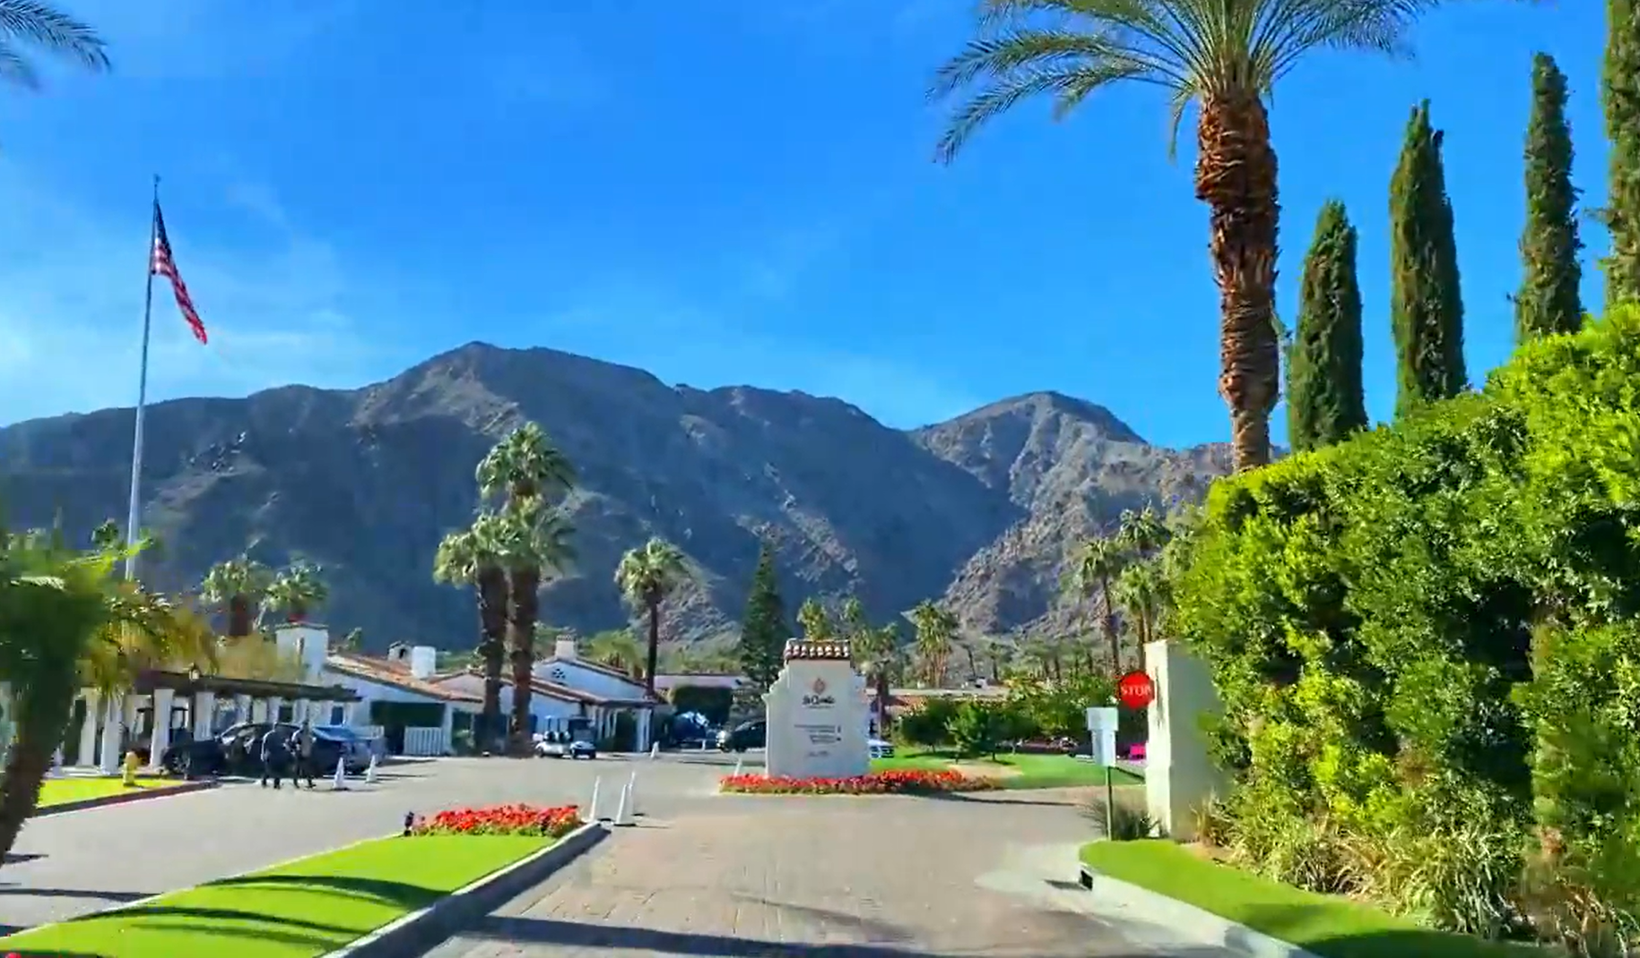


April 27-29, 2027
La Quinta Resort & Club
La Quinta, California

Slide 5
How many of you are here today for the first time?
“Newbies”

Slide 6
www.pipexch.com

Slide 7
www.pipexch.com
Subject: “From The Oil Patch”

Slide 8
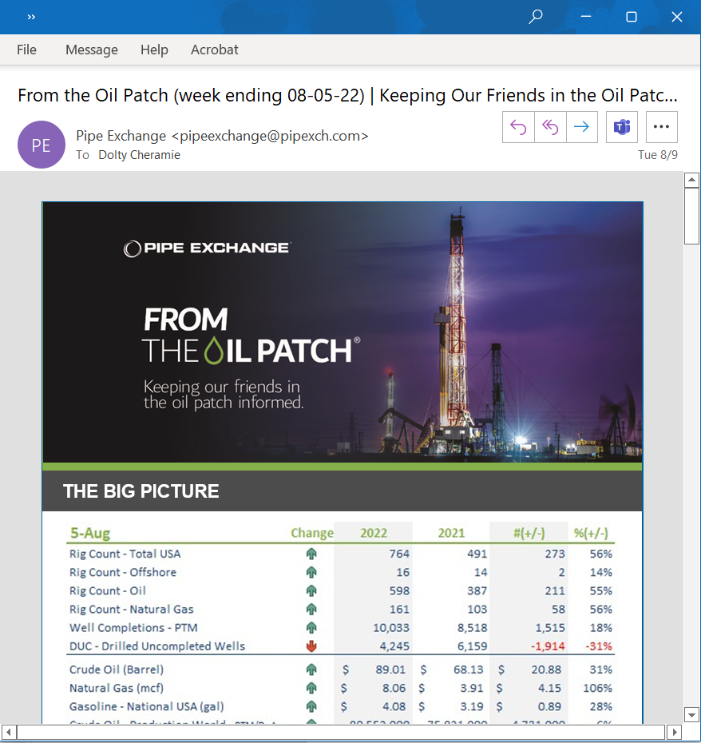

Slide 9
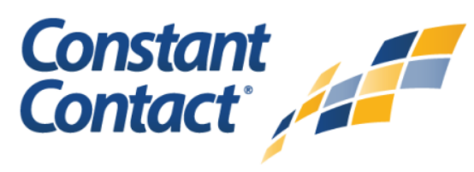
www.pipexch.com
Subject: “From The Oil Patch”
4,009

Slide 10
Let’s Get Started

Slide 11
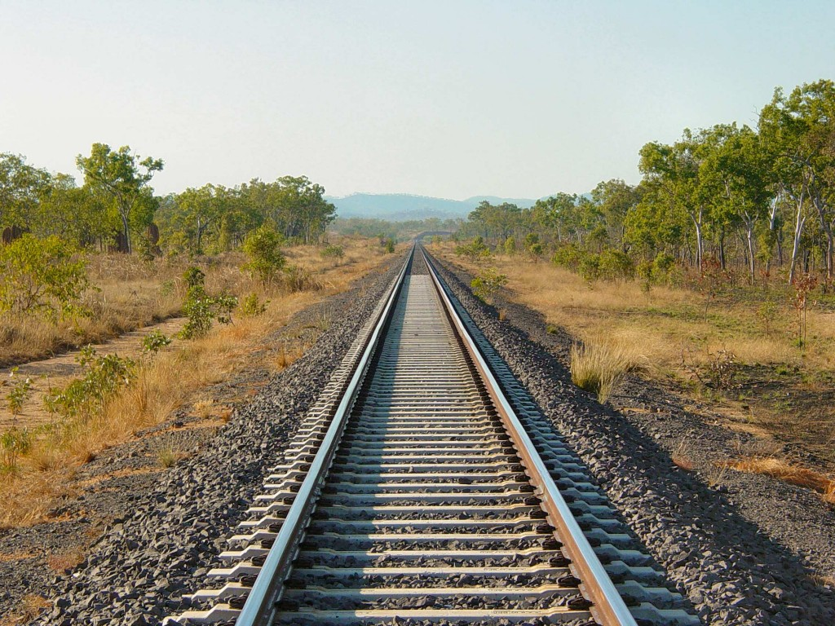

Slide 12
I am here to share with you my view of how we got here, and my guess as to where we’re headed…

Slide 13
“You are entitled to your own opinions, BUT, you are not entitled to your own facts.”

Slide 14
Connect The Dots…

Slide 16
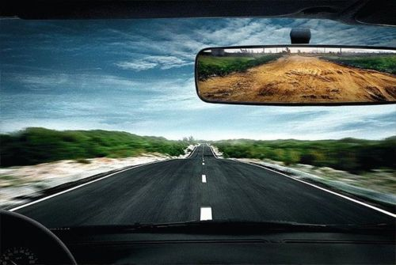
How We Got Here…

Slide 17
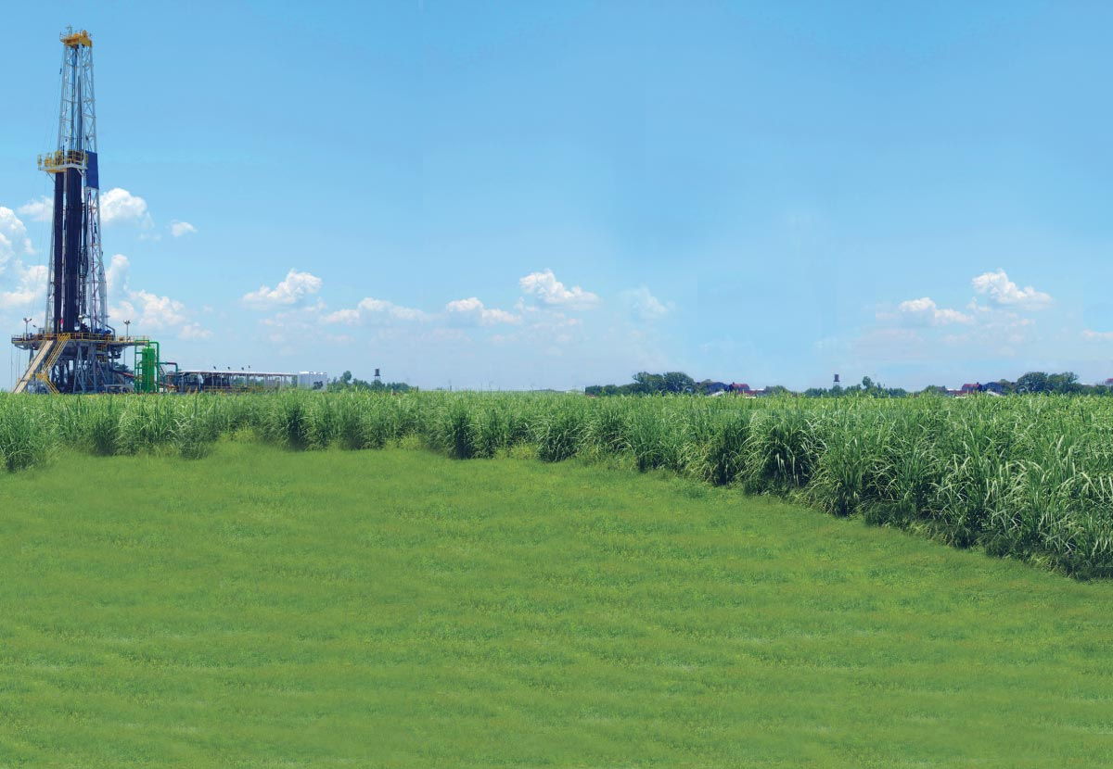

The Drivers
What drives our activity

Slide 18
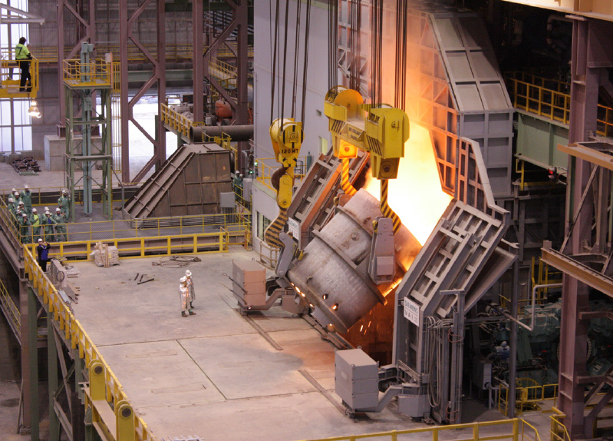
Raw Steel

Slide 19
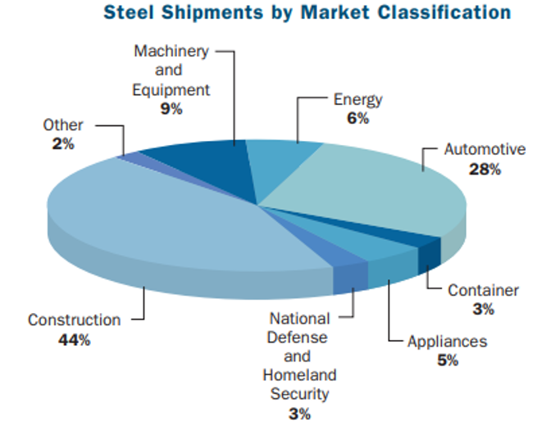
72%

Slide 20
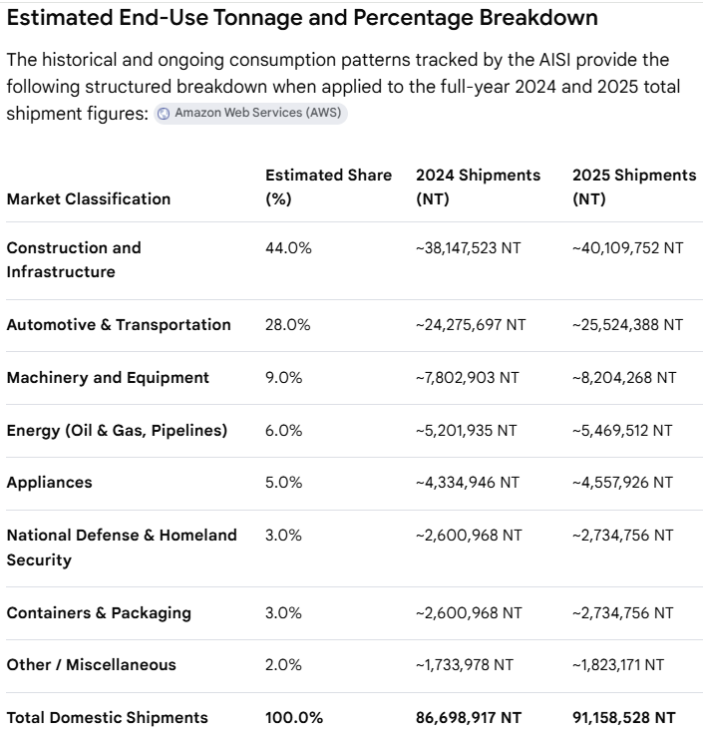

Slide 21
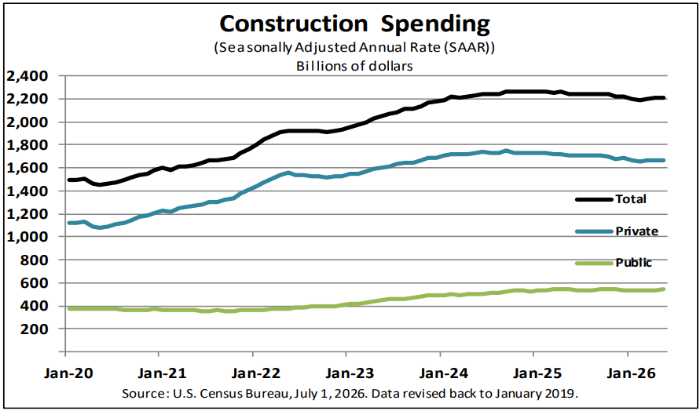

Slide 22
Infrastructure Investment and Jobs Act (IIJA)
commonly called the Bipartisan Infrastructure Law.
Signed: November 15, 2021, by President Joe Biden.
Bill: H.R. 3684
Law: Public Law 117-58
Total investment: About $1.2 trillion, including roughly $550 billion in new federal spending.
Purpose: Fund infrastructure projects across the country, including:
  Roads and bridges
  Public transportation
  Passenger and freight rail
  Airports, ports, and waterways
  Drinking-water and wastewater systems
  Broadband internet
  Electric-vehicle charging
  Power-grid improvements
  Environmental cleanup and climate resilience
It was bipartisan legislation, rather than a bill passed solely by the Biden administration—the administration supported it, but Congress passed it, and Biden signed it into law.

Slide 23
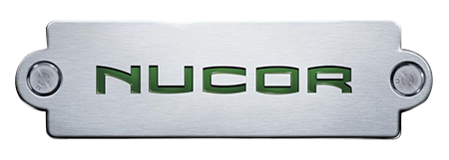
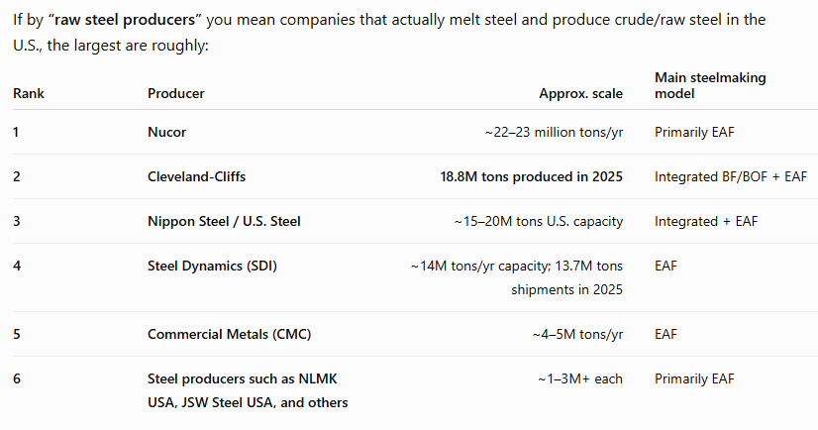

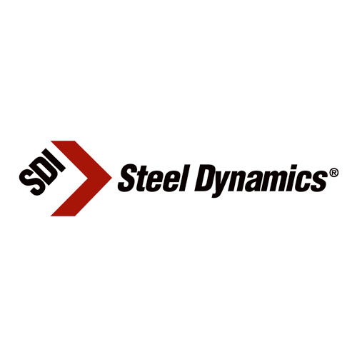
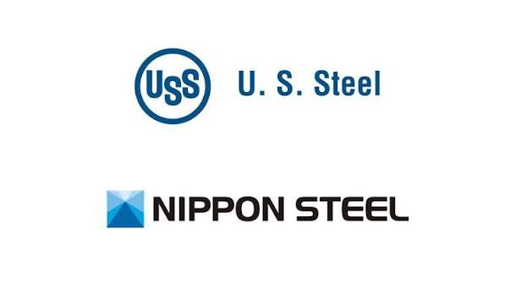
71%

Slide 24
Raw Steel

Slide 25
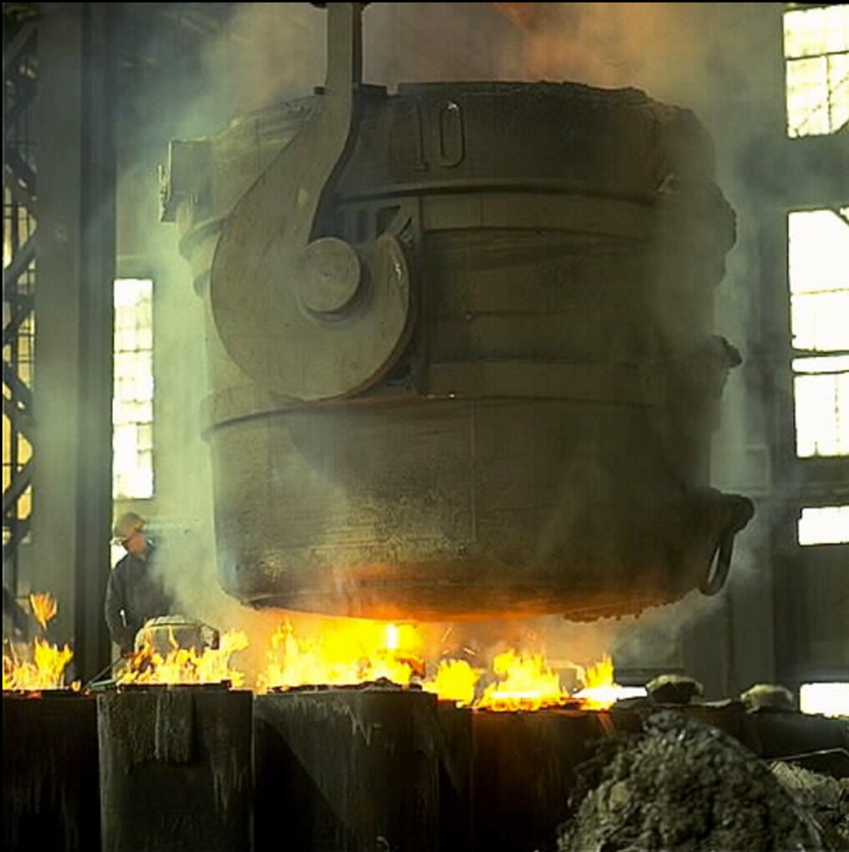

Slide 26
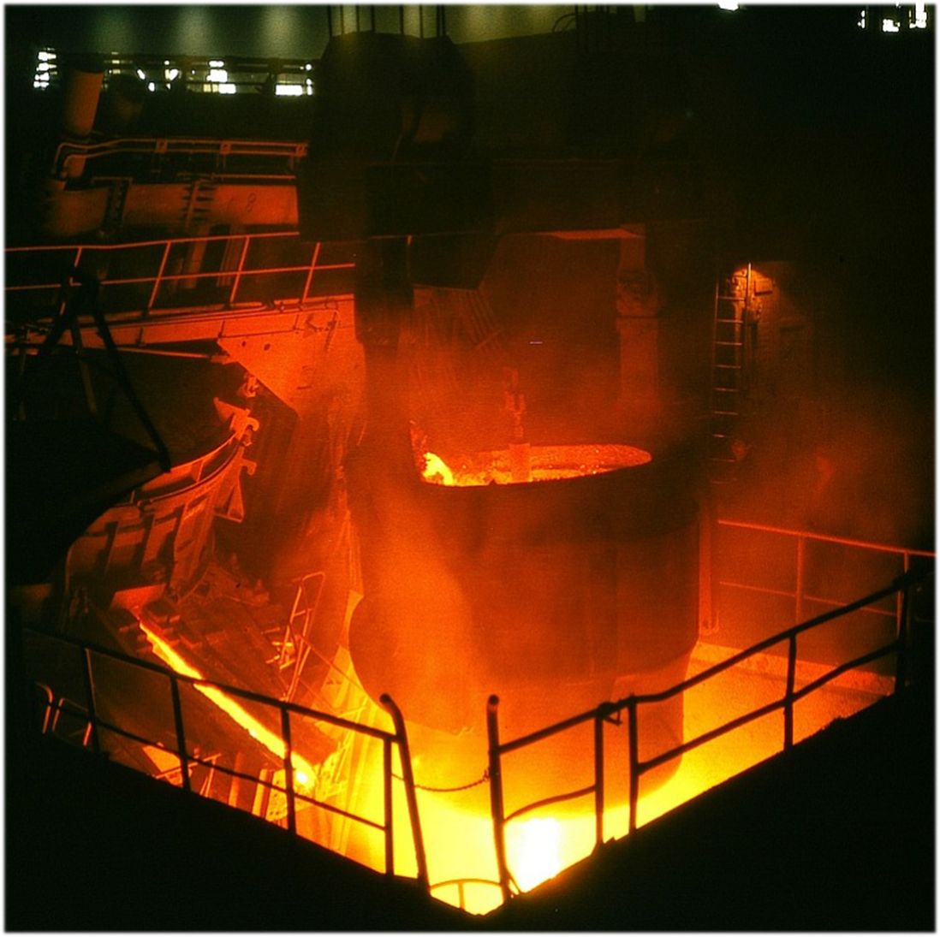

Slide 27
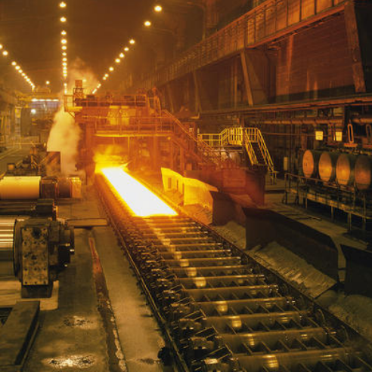

Slide 28
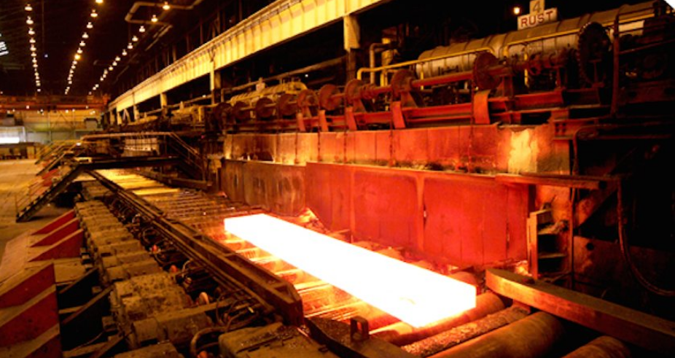

Slide 29
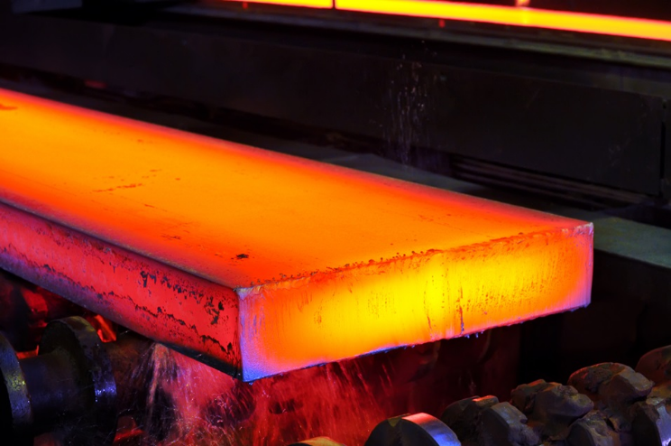

Slide 30
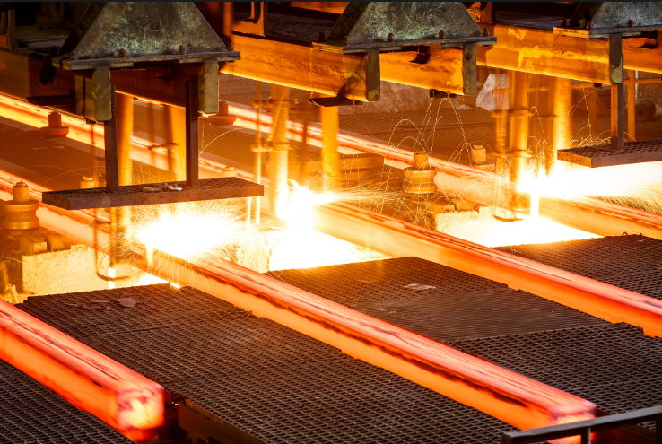

Slide 31
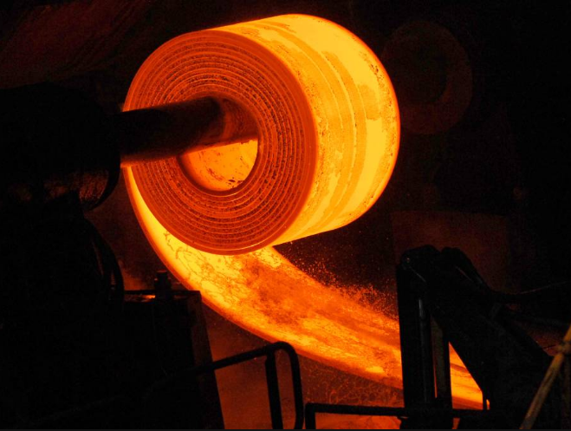

Slide 32
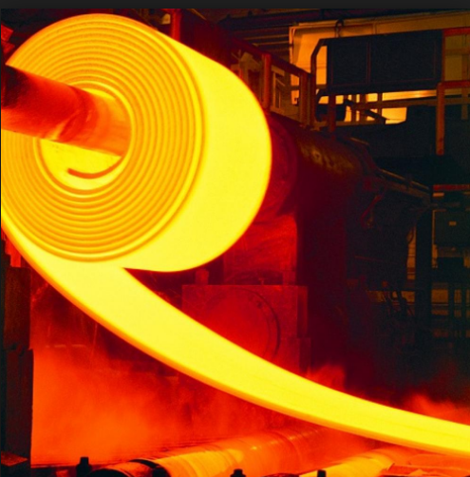

Slide 33
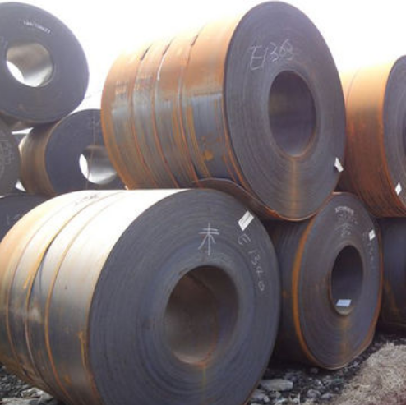

Slide 34
Connect The Dots…

Slide 35

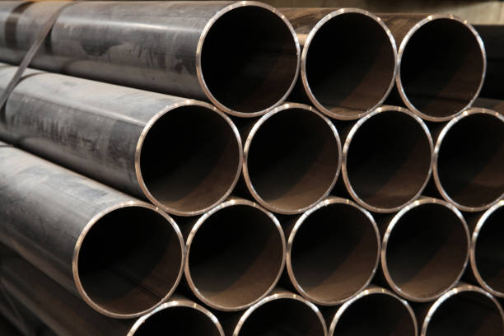

Slide 36
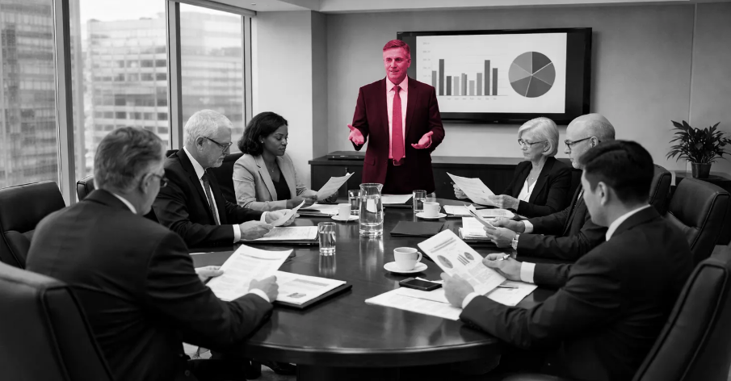
“Because We Can…”

Slide 37
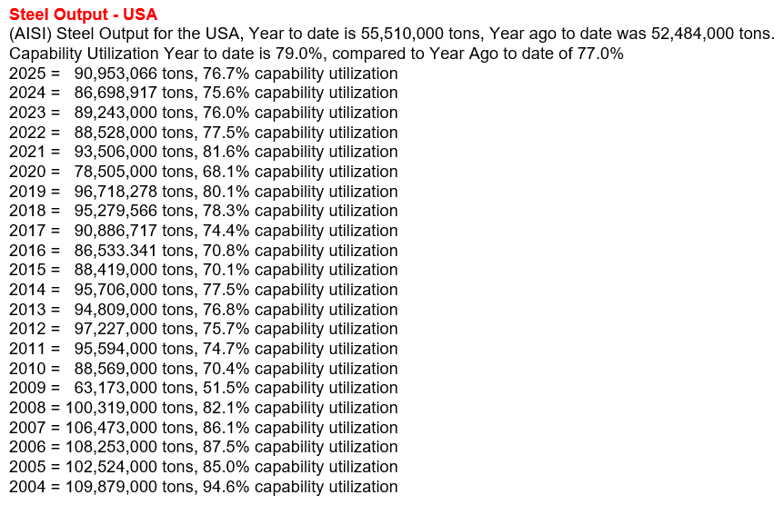

Slide 38
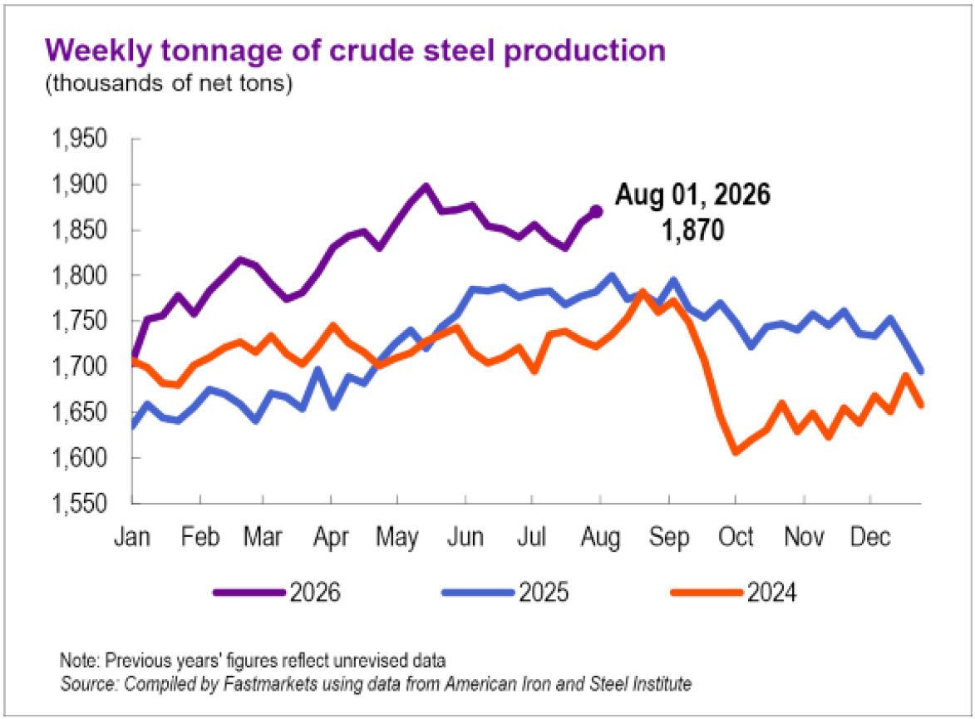
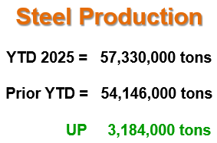

Slide 39

The Pie Keeps Shrinking

Slide 40
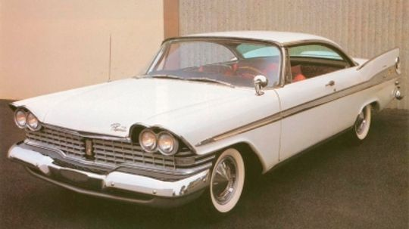
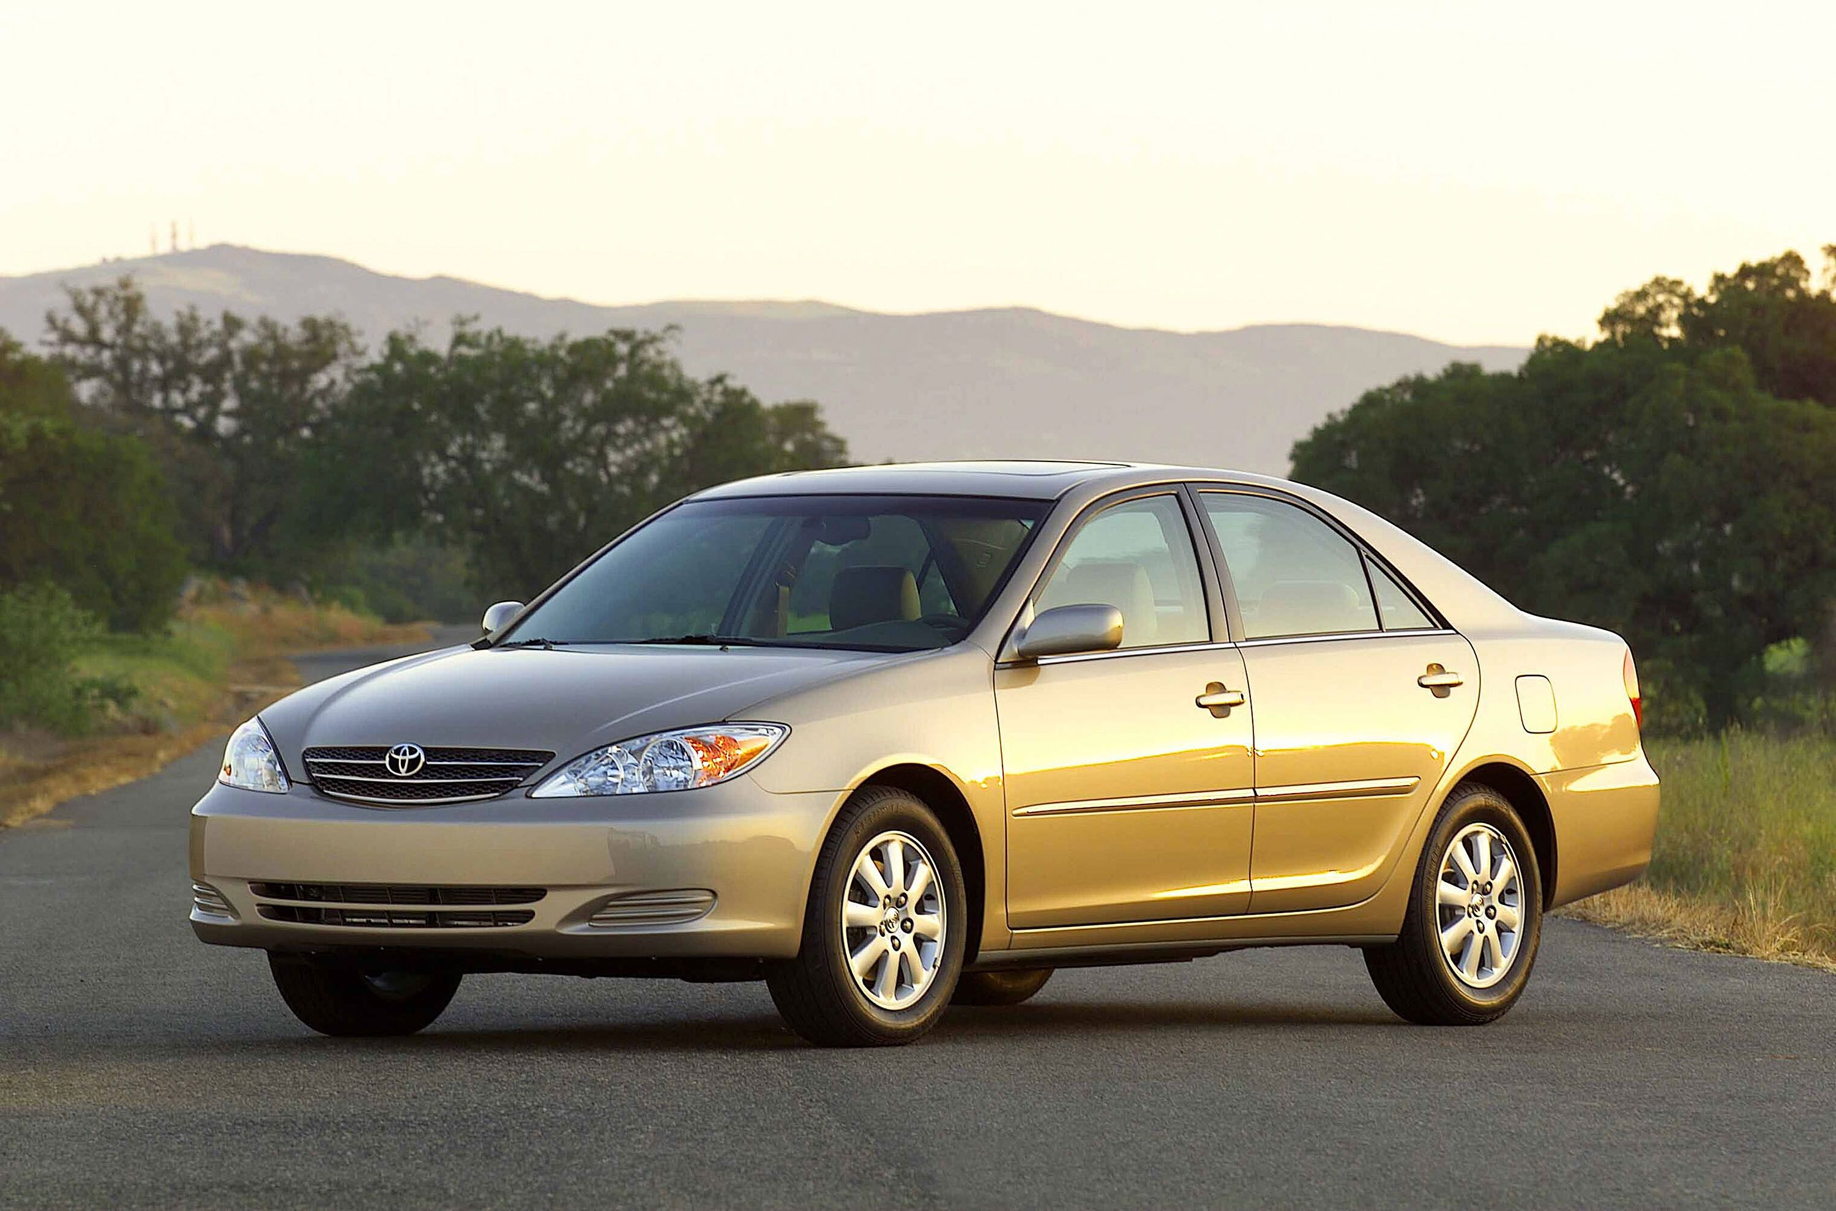
2.5 tons
1.4 tons

Slide 41
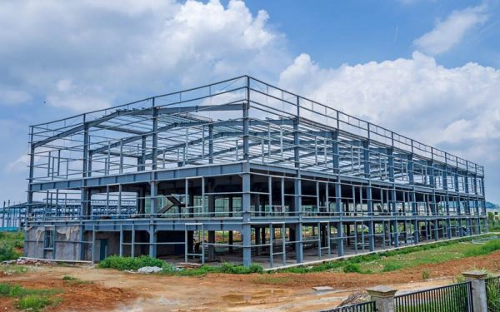
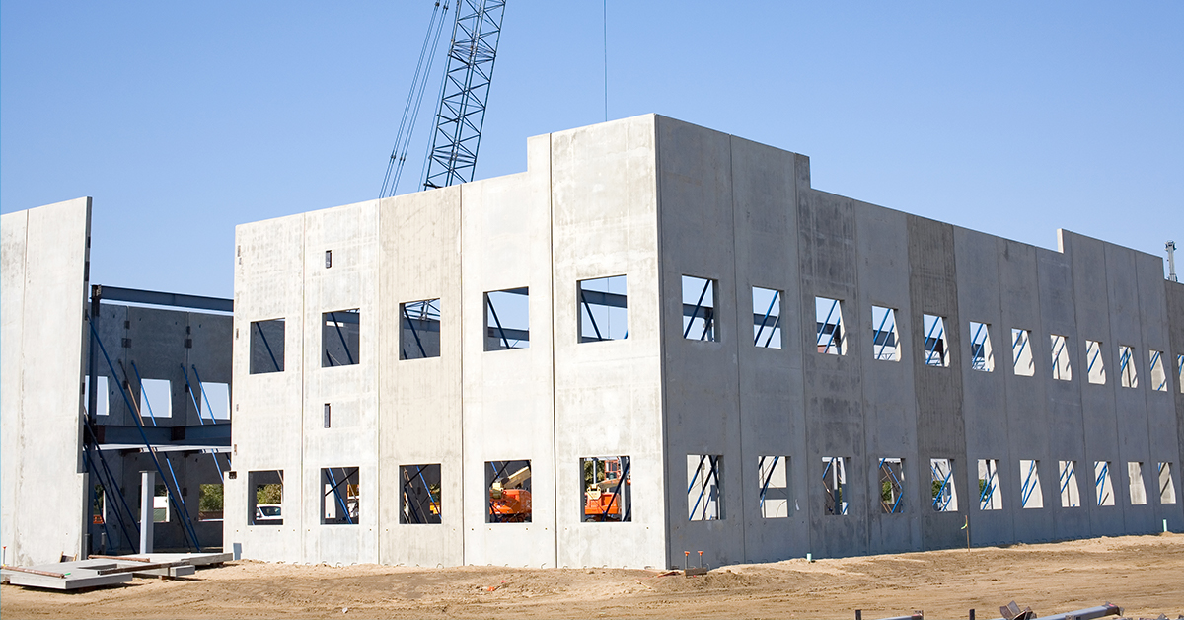
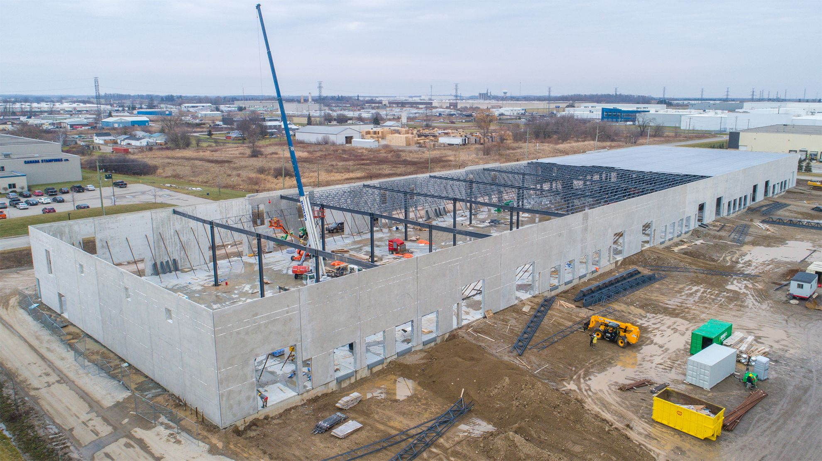
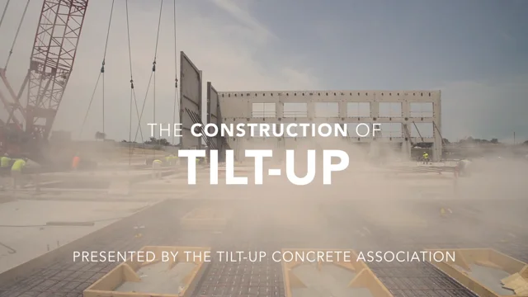

Slide 42
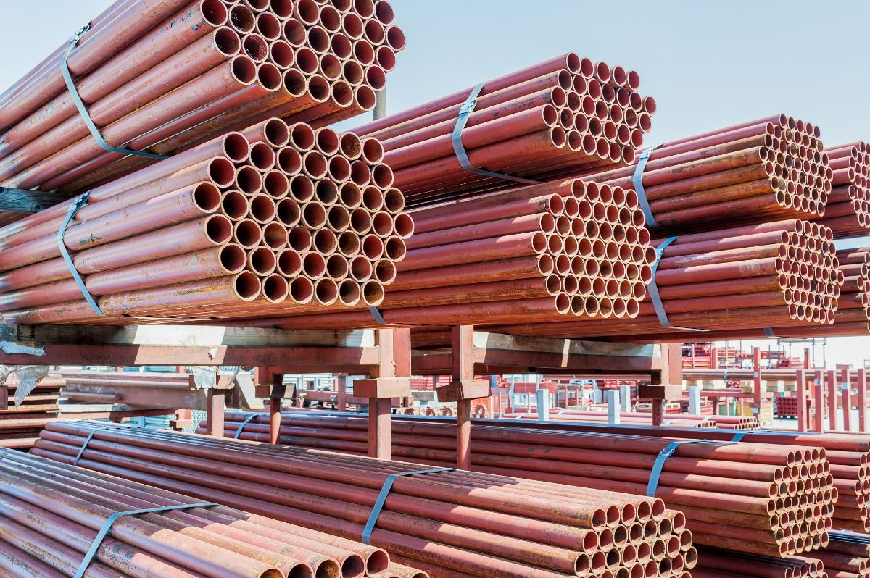
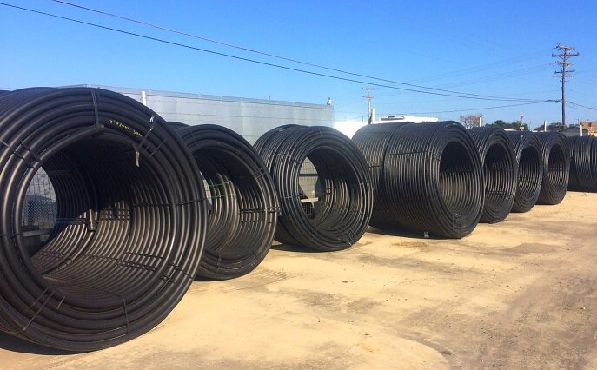
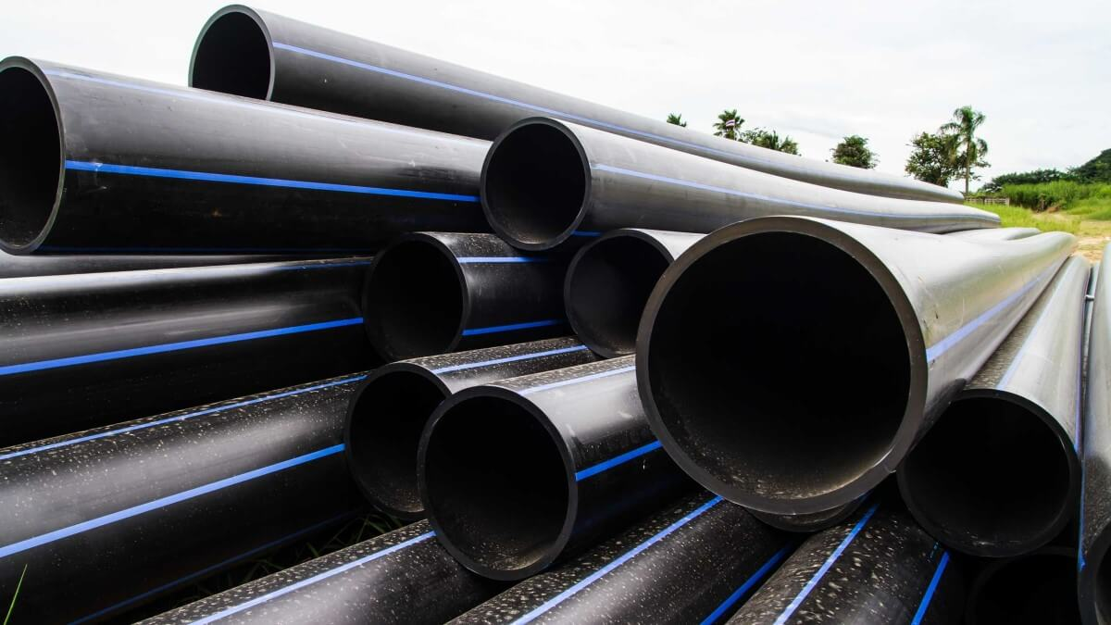

Slide 43
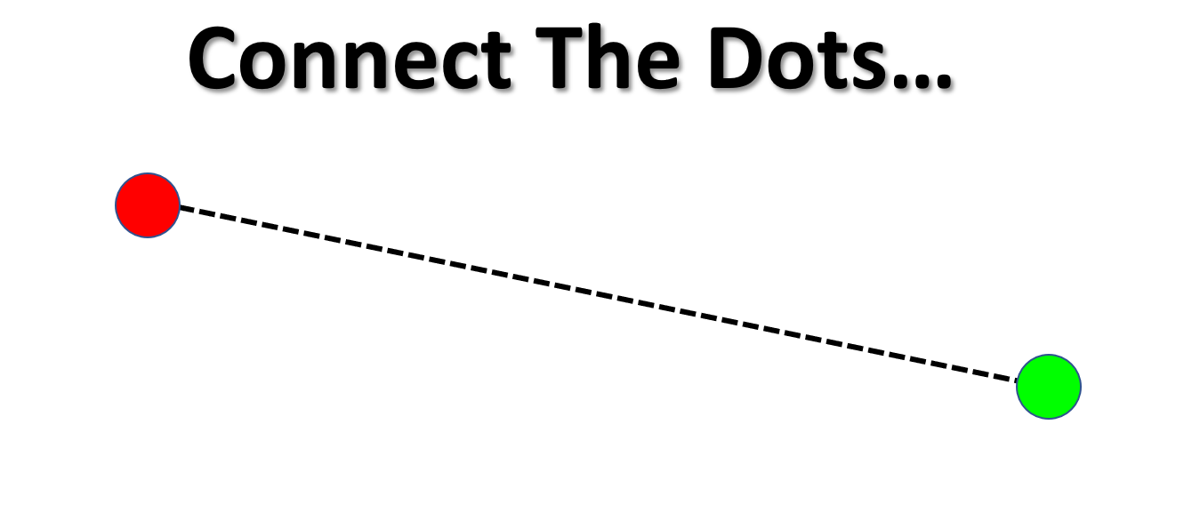

Slide 44

Biggest operating costs for a steel mill
For a typical steel mill, the major costs are:
Energy / electricity — very high
  Electric arc furnaces can consume enormous amounts of electricity.
  Natural gas is also significant for reheating furnaces, direct-reduced iron, etc.
  Energy prices can have a major impact on profitability.
Raw materials — usually the largest overall cost
  Scrap steel for EAF mills
  Iron ore, coking coal, and limestone for integrated mills
  Alloying materials such as nickel, chromium, manganese, etc.
Labor
  Operators, maintenance crews, engineers, electricians, mechanics, management, safety personnel, etc.
  Steelmaking is capital-intensive but still requires substantial skilled labor.
Maintenance
  Furnaces, rolling mills, cranes, pumps, cooling systems, electrical equipment, refractory linings, pollution-control equipment, etc.
  Maintenance can be extremely expensive because equipment is large and operates under extreme heat and mechanical stress.
Environmental costs
  Air-pollution control
  Wastewater treatment
Transportation
  Moving millions of tons of raw materials into the mill
  Moving finished steel out
  Rail, barge, truck, and sometimes ocean freight can all matter significantly.
If you're asking which one is the biggest
For many mills, raw materials are the largest cost category, while energy is one of the largest controllable operating expenses.

Slide 45
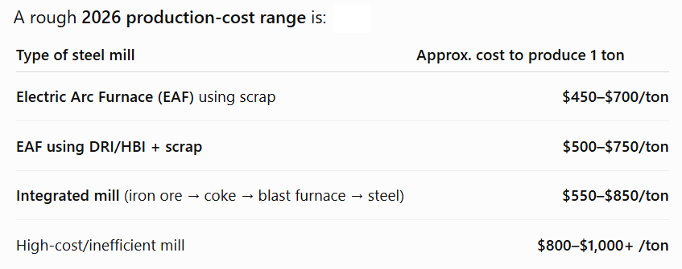
$700/ton

Slide 46
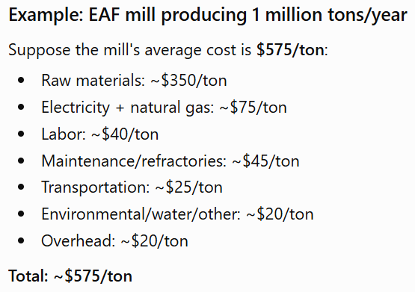

Slide 47
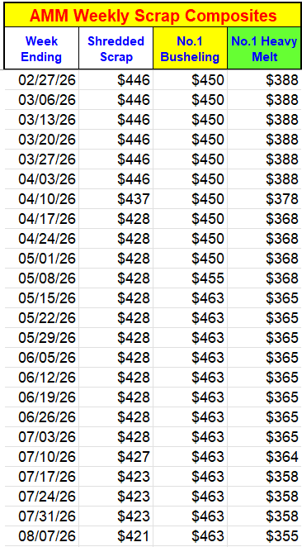
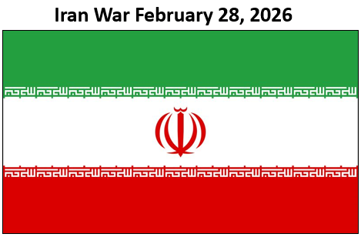
$388
$355

Slide 48
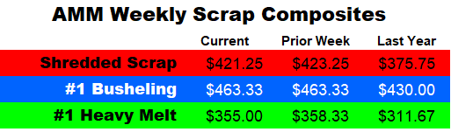
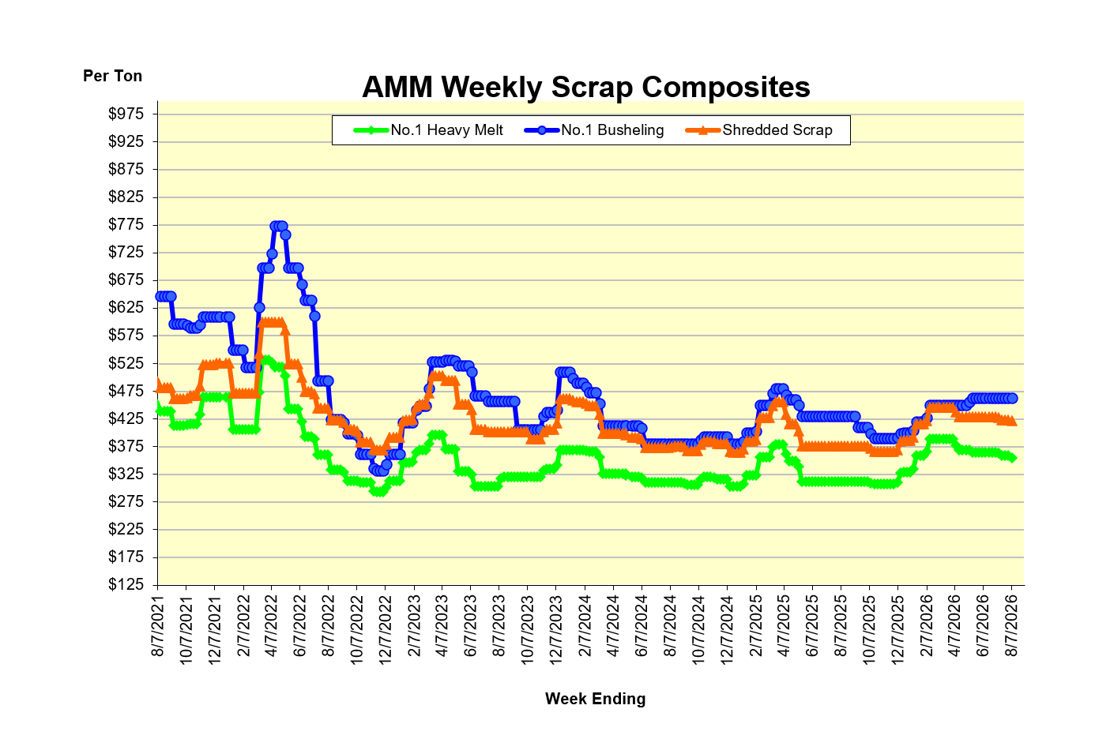

Slide 49
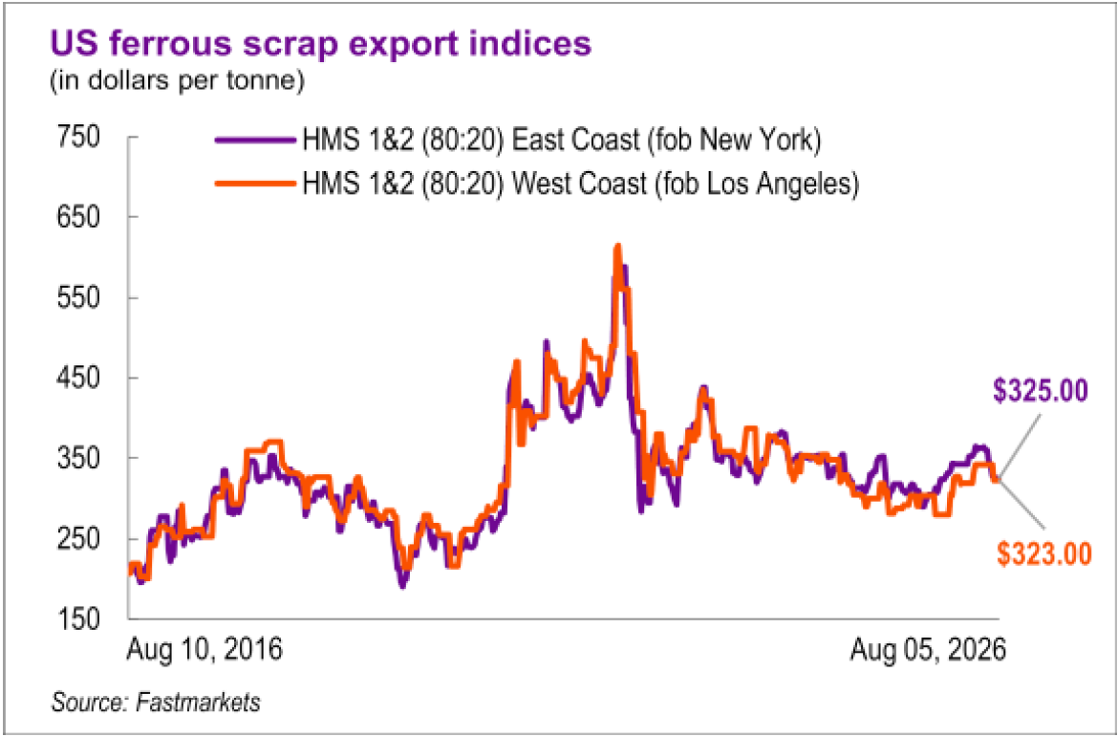

Slide 50
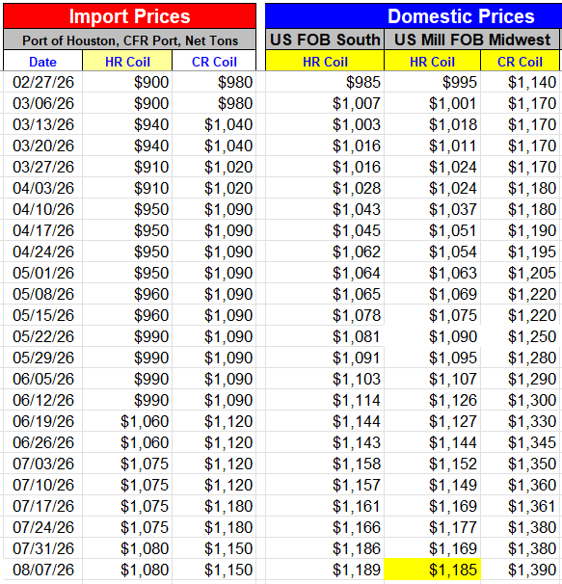
$995
$1,185

Slide 51
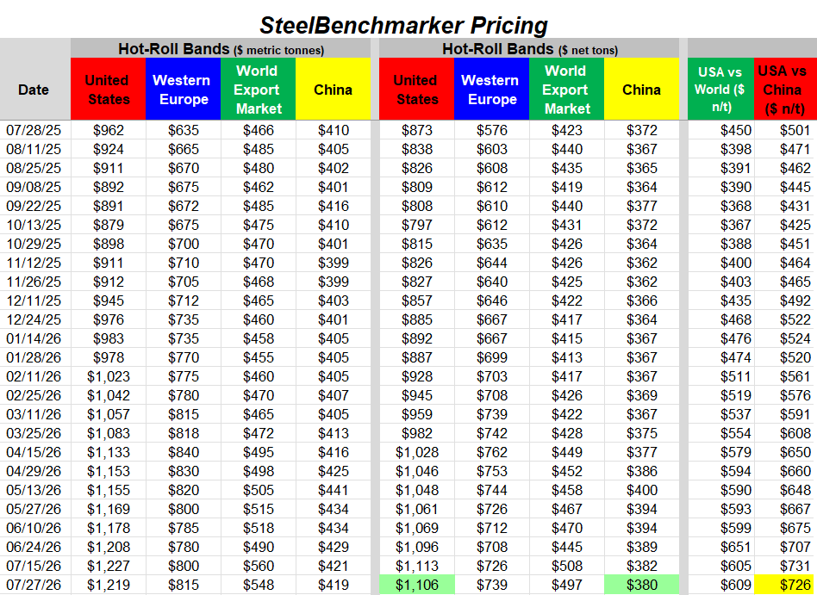
Hot Roll Coils
$1,106ton

Slide 52
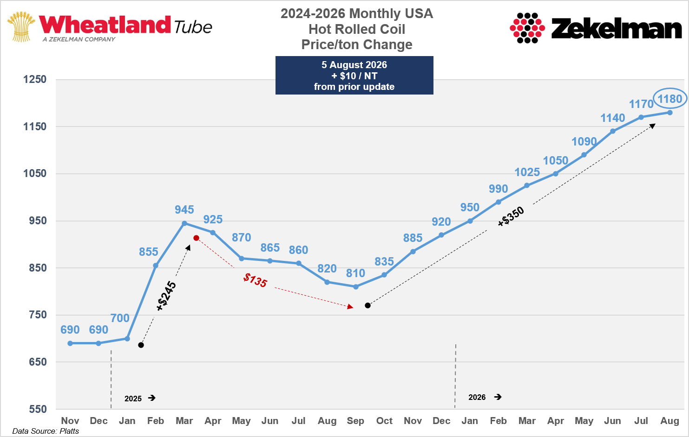

Slide 53
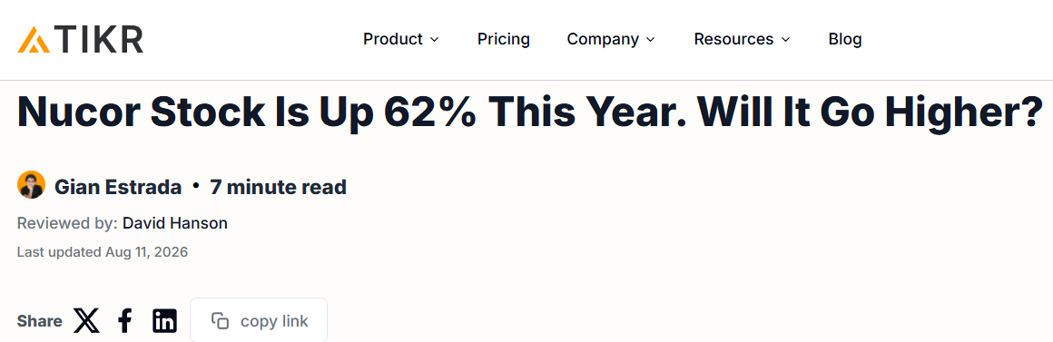
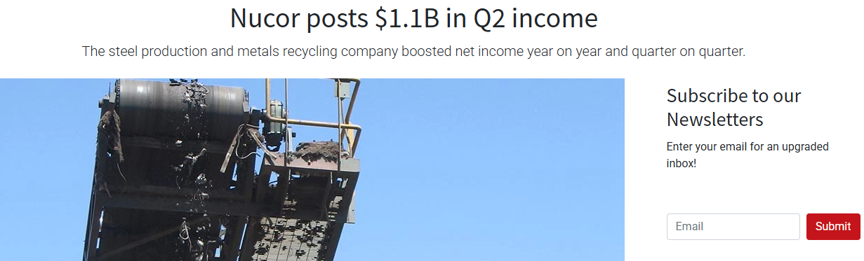




Slide 54


Slide 55
“Because We Can…”

Slide 56

Bananas for Sale

Slide 57



Slide 58

China

Slide 59


Slide 60


Slide 61


Slide 62


Slide 63

Tariffs
Tariffs
Tariffs
Tariffs
Tariffs
Tariffs
Tariffs
Tariffs
Tariffs
Tariffs
Tariffs

Slide 64

Tariffs
Tariffs
Tariffs
Tariffs
Tariffs
Tariffs
Tariffs

Slide 65
Continue to Part 2

