Slide 1
Washington Update: Trump's Steel Policy and Politics
Samir Kapadia
Managing Principal at the Vogel Group
NAPCA Annual Conference | April 2026

Slide 2

The Vogel Group is an international government affairs and consulting firm headquartered in Washington D.C serving startup companies, corporations, associations, and asset managers around the world.
Our firm provides strategic counsel and government affairs support in managing, responding to and capitalizing on government risk and opportunities.

Slide 3

Samir Kapadia
Name, Title
Managing Principal
Having spent over a decade in policymaking and consulting in Washington, D.C., New York, and Mumbai, Samir helps some of the largest companies in the world understand how Washington can create risk or drive business growth. With a bipartisan background, his previous policy experience includes serving in the offices of Senator Mark Warner (D-VA) and Congressman Frank Wolf (R-VA). Samir has been named a Top Lobbyist by The Hill in 2023, 2024, and 2025. In 2025, Samir was also named as one of Washington, DC’s 500 Most Influential, recognizing his work in trade policy, by Washingtonian Magazine.
Samir leads the Vogel Group’s trade practice, advising clients on tariffs and supply chain strategy. Samir is a frequent speaker on trade-related matters and regularly appears on FOX News, FOX Business, CNBC, The Wall Street Journal, The New York Times, Reuters, The Washington Post, POLITICO, CBS News, S&P Global, Fastmarkets AMM, and other media outlets. Samir is also recognized as an expert on issues related to metals, mining, and energy industries, having worked on domestic manufacturing, trade, workforce, and permitting issues for both international and domestic clients. He has worked on hundreds of Section 232, 301, 201, and IEEPA cases on behalf of some of the largest manufacturers in the world.

Slide 4
Agenda
Trump 2.0 Trade Architecture
The Strategic Rationale Behind Trump’s Trade Revolution
Liberation Day to IEEPA’s Fall: The Tariff Timeline
Legal Landscape: IEEPA Struck Down, New Battles Ahead
Iran War & Impact on Global Trade
The Post-IEEPA Legal Landscape: Section 122, 301, and Beyond
Section 232: The Steel Industry’s Centerpiece
Trump 2.0 Trade Deals - Status After the IEEPA Ruling
U.S.-China Strategic Dance: From Escalation to Negotiation
Impact on Steel & Pipe Coating
What Comes Next: The Next 6 Months

Slide 5
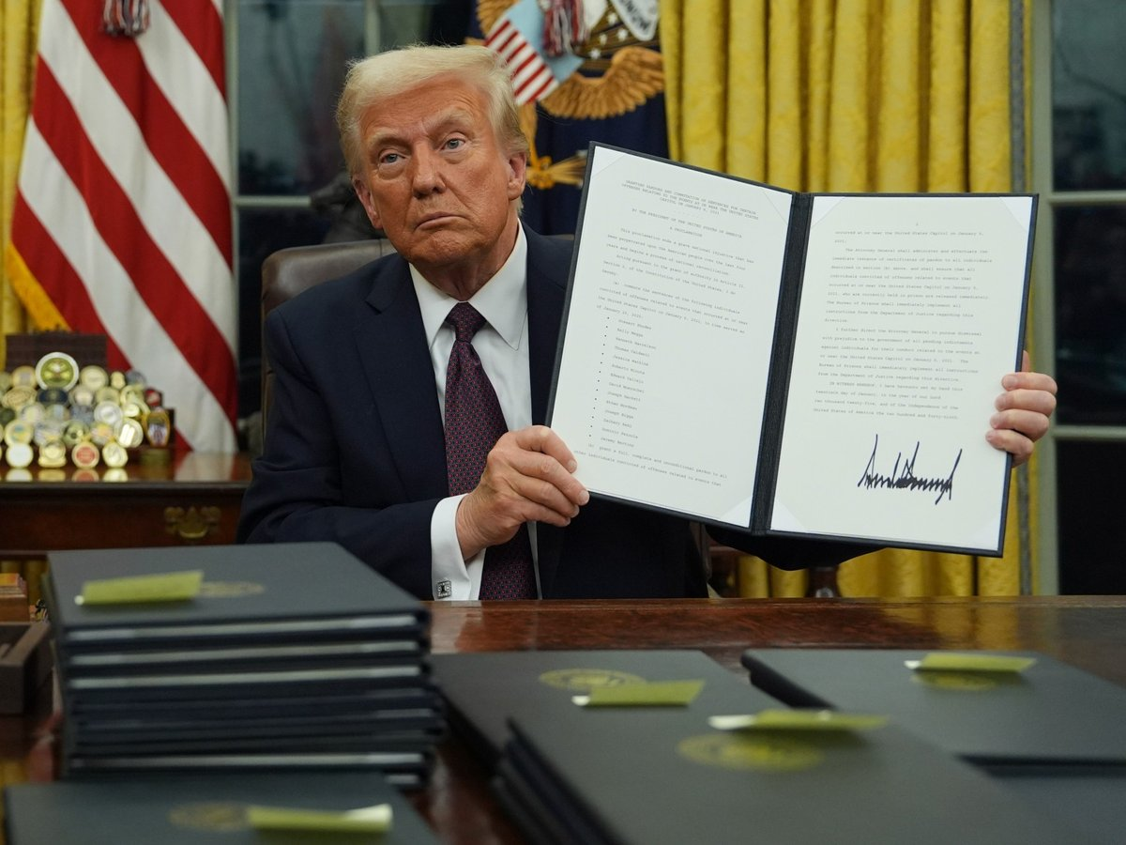
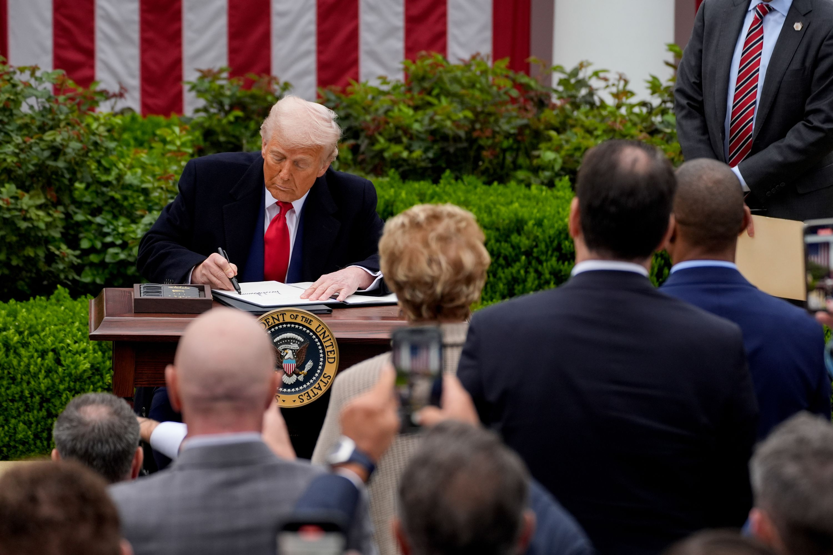
Trump 2.0 Trade Architecture
The Campaign Promise to Reality: Trump's second-term trade policy has undergone a dramatic legal and strategic reset. After a year of aggressive tariff action under IEEPA, the Supreme Court struck down that authority in February 2026. The administration has pivoted to alternative legal tools while maintaining its core mission of economic sovereignty and supply chain reshoring.
The "America First" Economic Security Framework: Then and Now
Day One Foundation: Trump's initial flurry of Executive Orders established the America First Trade Policy with comprehensive multi-agency reviews of international trade practices (Feb 2025)
"Liberation Day" (April 2): Trump invoked International Emergency Economic Powers Act (IEEPA) authority to implement "reciprocal" tariffs on nearly all trading partners, with rates up to 50% on some countries.
The Reset (Feb 20, 2026): Supreme Court ruled 6-3 in Learning Resources v. Trump that IEEPA does not authorize tariffs. All IEEPA tariffs terminated Feb 24, 2026. Administration pivoted to Section 122 (10% global surcharge) and launched sweeping Section 301 investigations.

Slide 6
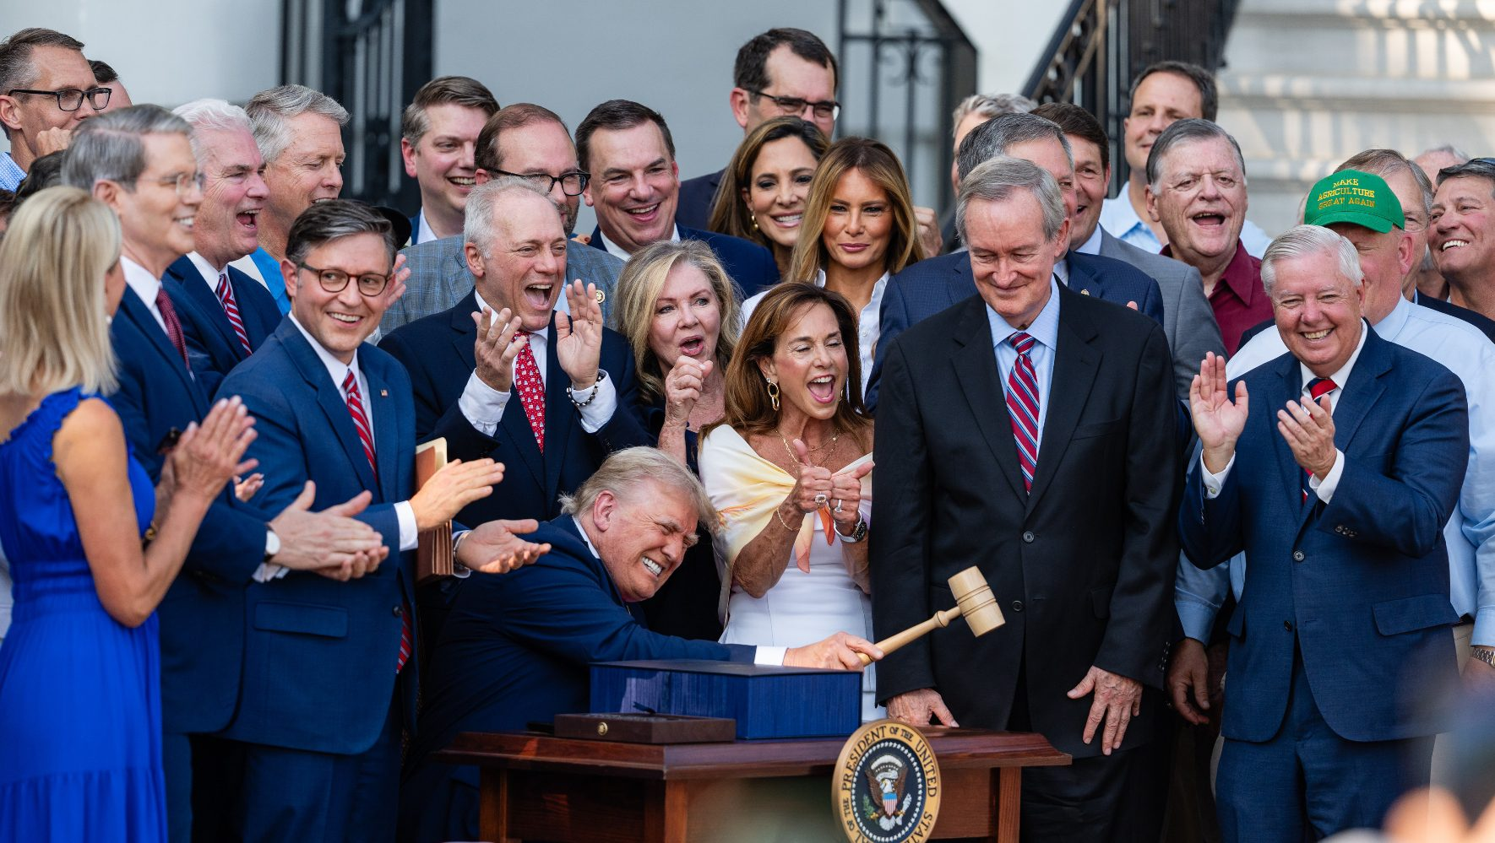
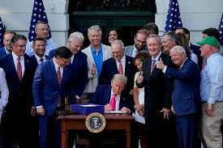
The Strategic Rationale Behind Trump's Trade Revolution
The Re-shoring Gambit: The administration's central thesis: decades of internationally sourced supply chains have created dangerous dependencies that compromise both economic and national security. Trump's team argues that "reciprocal" tariffs will force trading partners to abandon unfair practices while incentivizing domestic production.
The Great Economic Experiment: This represents Trump's greatest gamble to revive domestic manufacturing, betting that short-term market volatility and supply chain disruption will yield long-term strategic advantages. The policy deliberately prioritizes domestic production capacity over immediate cost efficiency, fundamentally challenging the globalized trade model that has dominated for decades.
Market Reality Check: After a year of tariff-driven disruption, the Supreme Court's IEEPA ruling has reset the playing field. Critically for the steel industry, Section 232 tariffs were unaffected by the ruling and remain the backbone of U.S. metals trade policy. The April 2026 Section 232 overhaul raised steel tariffs to 50% on full customs value, the strongest protection domestic steel producers have seen in decades. Meanwhile, the 150-day Section 122 window expires July 24, 2026.

Slide 7
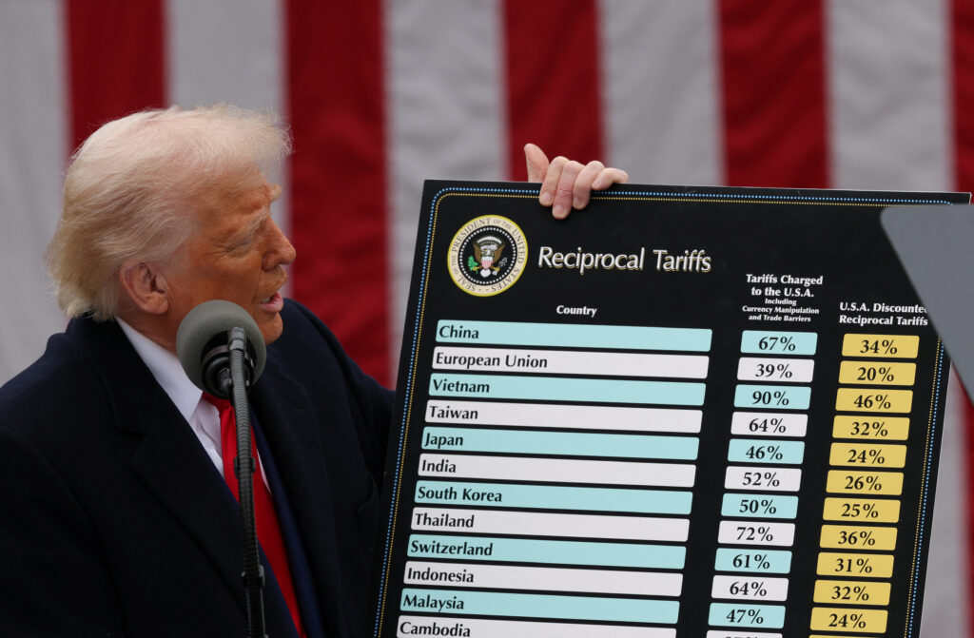
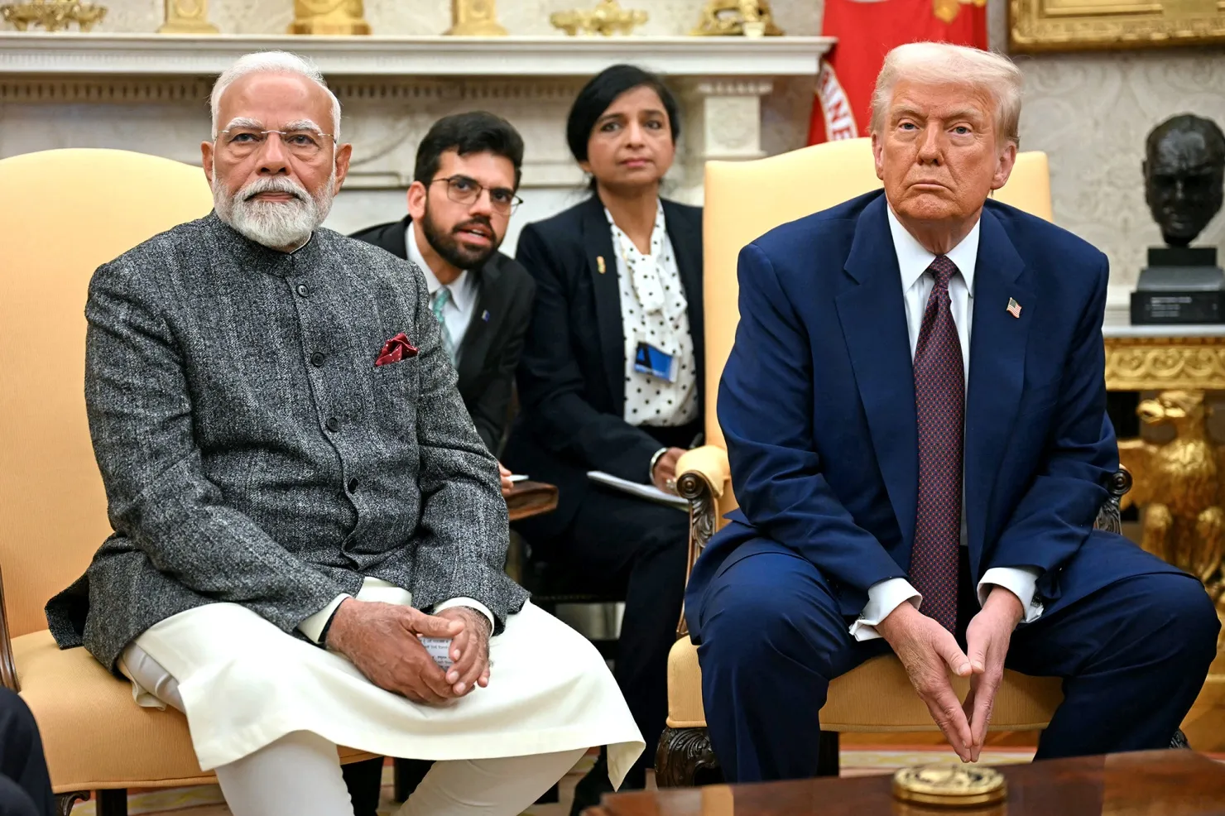
Liberation Day to IEEPA’s Fall: The Tariff Timeline
Liberation Day (April 2, 2025)
President Trump used IEEPA to authorize wide-ranging tariffs on foreign imports. These tariffs were struck down by the Supreme Court on February 20, 2026.
April 9: Several higher tariff rates put on 90-day pause while maintaining the new 10% global baseline tariff
Current Global Implementation
August 7: New tariffs on imports from more than 90 countries went into effect
India Escalation: IEEPA tariff rate was doubled from 25% to 50% (suspended Feb 7, 2026, ahead of SCOTUS ruling)
Brazil Section 301 Investigation: IEEPA rate was increased from 10% to 50%. All IEEPA tariffs on Brazil terminated Feb 24, 2026 per SCOTUS ruling.
Other Policy Adjustments
July 30: Executive order suspended zero-tariff exemptions for low-value shipments (de minimis), effective August 29, 2025 - accelerating timeline by two years from the One Big Beautiful Bill Act's original July 2027 date
September 6: Executive order modified scope of reciprocal tariffs, adding bullion and several critical minerals to exemptions while removing certain aluminum, resin, and silicone products from exemptions (effective September 8)
Feb 20, 2026: SCOTUS strikes down all IEEPA tariffs (6-3). Feb 24: IEEPA tariffs terminated. Section 122 global 10% surcharge takes effect. Administration to begin refunds.
U.S. President Donald Trump & Indian Prime Minister Narendra Modi

Slide 8

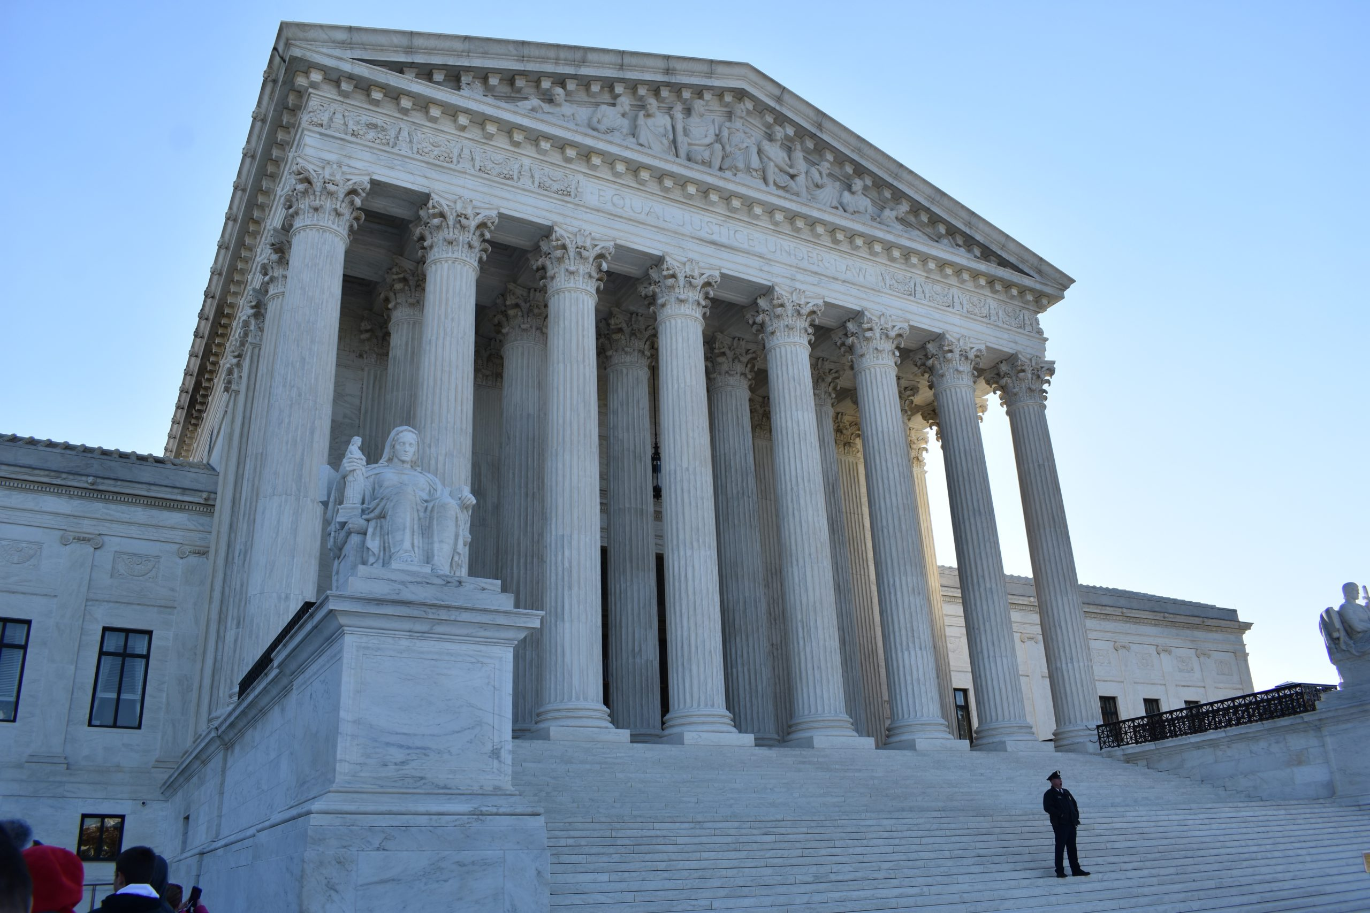
Legal Landscape: IEEPA Struck Down, New Battles Ahead
February 20, 2026: The Supreme Court ruled 6-3 in Learning Resources v. Trump that IEEPA does not authorize the President to impose tariffs. Chief Justice Roberts authored the opinion, joined by Justices Sotomayor, Kagan, Gorsuch, Barrett, and Jackson. Justices Thomas, Alito, and Kavanaugh dissented.
The Court held that the power to impose tariffs is a branch of the taxing power^{th} that Article I, Section 8 vests exclusively in Congress. The ruling invalidated all IEEPA tariffs: reciprocal tariffs, fentanyl trafficking tariffs on Canada/Mexico/China, the India and Brazil escalations, and secondary tariff orders. All IEEPA tariffs terminated effective February 24, 2026.
Refunds & New Tariff Actions:
IEEPA Tariff Refunds: Estimated $175 billion in IEEPA tariffs collected. Over 2,000 lawsuits filed at the Court of International Trade seeking refunds. CIT ordered CBP to begin processing refunds with interest (accruing at ~$650M/month). CBP developing automated “CAPE” refund system, expected within 45 days of the March 4 order.
Section 122 Legal Challenge: 24 state attorneys general and business groups filed lawsuits challenging the 10% global surcharge. Oral arguments at CIT scheduled for April 10, 2026. Challengers argue Section 122 requires balance-of-payments problems that do not exist under floating exchange rates.
Business Implications: Companies face continued uncertainty. Section 122 tariffs expire July 24 unless Congress acts. Section 301 investigations could yield new, permanent tariffs but require months of procedural steps. Importers should preserve records of all IEEPA tariff payments and file protests with CBP. Note: Section 232 steel and aluminum tariffs were NOT affected by the IEEPA ruling and remain fully in effect at 50%.
Current Tariff Authorities:
Section 301
Section 338
Section 122 (10% global, expires July 24)
  150-day stopgap, facing legal challenge
Section 301 (76 new investigations)
  Excess capacity (16 economies) + forced labor (60 economies)
Section 232 (ongoing)
  Steel, aluminum, autos, lumber, semiconductors, and more

Slide 9
Iran War & Impact on Global Trade
The Conflict and Energy Markets:
Timeline: February 28, 2026 - U.S. and Israel launched strikes on Iran ("Operation Epic Fury"). Iran retaliated with missile/drone strikes on U.S. bases in Qatar, UAE, and Bahrain, and closed the Strait of Hormuz. April 7-8 ceasefire reached after 5+ weeks of fighting. Negotiations in Pakistan fell apart, the U.S. Navy is blockading Iranian ports.
Strait of Hormuz Disruption:
  The Strait carries ~20% of global oil and ~20% of global LNG trade. Commercial traffic dropped more than 90% after the outbreak of conflict.
  Brent crude surged from ~$72 to nearly $120/barrel at peak, later stabilizing around $111. U.S. retail gas prices rose 93 cents/gallon. IEA estimated ~9-11 million bpd of oil supply effectively removed.
  Shipping reroutes, surging war risk insurance, and Red Sea avoidance have compounded supply chain pressures.
  Asian economies (heavily oil-import-dependent) faced fuel shortages and rationing.
U.S. Trade Policy Response:
March 3: Trump ordered DFC to provide political risk insurance for "ALL Maritime Trade" through the Gulf.
U.S. temporarily eased Iranian oil sanctions to release ~140M barrels of stranded oil to global markets.
Impact on steel and pipe coating: Rising energy costs driving up steel production expenses. Gulf shipping disruptions affecting raw material imports. Pipe coating operations tied to oil and gas infrastructure face project delays as operators reassess capital spending amid energy price volatility.

Slide 10
The Post-IEEPA World: Section 122, 301, and Beyond
The New Tariff Architecture After IEEPA:
Section 122 (Trade Act of 1974): 10% global surcharge effective Feb 24, 2026. Expires July 24. Facing legal challenges from 24 states at CIT. Oral arguments April 10, 2026.
Section 301 Investigations (March 2026):
  Excess Manufacturing Capacity: 16 economies including China, EU, Japan, India, Mexico, Vietnam, South Korea
  Forced Labor Import Prohibitions: 60 economies covering 99%+ of U.S. imports
  Public comment deadline: April 15, 2026. Hearings: April 28 (forced labor) and May 5 (overcapacity)
  Section 301 tariffs are not time-bound or rate-capped like Section 122
Remaining Authorities Still in Effect:
Section 232 tariffs on steel (50%), aluminum (50%), copper (50%), autos, lumber - unaffected by SCOTUS, overhauled April 6, 2026
Existing Section 301 tariffs on China (from Trump 1.0 and Biden era) - unaffected
PTAAP framework and bilateral trade deals remain in effect but enforcement mechanism has shifted
Strategic Outlook: Treasury Secretary Bessent has stated that combining Section 122, Section 232, and Section 301 tariffs "will result in virtually unchanged tariff revenue in 2026." The administration is using the 150-day Section 122 window to build procedural groundwork for permanent Section 301 tariffs.

Slide 11
Section 232: The Steel Industry’s Centerpiece
Section 232 Tariff Rate Changes
On April 3rd, a 25% tariff rate on imported automobiles was instituted. Specific auto parts faced a 25% tariff on May 3rd.
Recent Section 232 Investigation Tariff Announcements
  September 30th | Commerce Department issued a 10 percent tariff on imported lumber and timber imports as well as an additional 25% tariff on kitchen cabinets and furniture. [Rates will rise to 30 percent on furniture and 50 percent on kitchen cabinets on Jan 1,2026]
  April 6th | Major Section 232 overhaul: 50% tariff on full customs value for steel articles (pipe, tubing, plate, coils in Annex I-A). 25% on derivatives with >15% metal content (Annex I-B). Tariffs now apply to full entered value. Prior quarterly inclusion process terminated.
Strategic Pattern: Section 232 is now the administration's most powerful remaining tariff tool. The April 2026 overhaul restructured the entire framework: steel pipe, tubing, and mill products now face a 50% tariff on full customs value (Annex I-A). Derivative products with over 15% steel content by weight face 25% on full value. UK steel gets preferential 25% rate under the Economic Prosperity Deal. For NAPCA members, imported steel pipe and coating materials are directly in the crosshairs of these restructured duties.
Active Section 232 Investigations | Initiation Date
Copper | March 10, 2025
Timber and Lumber | March 10, 2025
Semiconductors and Semiconductor Manufacturing Equipment | April 1, 2025
Pharmaceuticals and Pharmaceutical Ingredients | April 1, 2025
Trucks | April 22, 2025
Processed Critical Minerals and Derivative Products | April 22, 2025
Commercial Aircraft and Jet Engines | May 1, 2025
Polysilicon and its Derivatives | July 1, 2025
Unmanned Aircraft Systems (UAS) and Their Parts and Components | July 1, 2025
Wind Turbines | August 13, 2025
Personal protective equipment, medical consumables, and medical equipment including devices. | September 2, 2025
Robotics and Industrial Machinery | September 26, 2025
Steel, Aluminum & Copper | Overhauled April 6, 2026 (50% full-value)

Slide 12
Trump 2.0 Trade Deals - Status After the IEEPA Ruling
United Kingdom (May 8, 2025):
Expanded U.S. market access in the UK, creating a $5 billion opportunity for new exports for U.S. farmers, ranchers, and producers
UK reciprocal rate set at 10%; 100,000 vehicle quota on UK cars at 10%, additional vehicles subject to 25% (Section 232)
Indonesia (July 22, 2025):
Indonesia will eliminate nearly all tariff barriers on U.S. products (over 99%) and address non-tariff barriers to U.S. agricultural products in the Indonesian market
Indonesia reciprocal rate set at 19%
Japan (July 22, 2025):
$550 billion direct investment commitment
Japan reciprocal rate set at 15% (inclusive of MFN)
Commitment to increase purchases of U.S. agricultural products, U.S. energy exports, and U.S.-made commercial aircrafts
European Union (July 27, 2025):
$600 billion investment commitment
EU reciprocal rate set at 15% (inclusive of MFN)
Commitment to purchase $750 billion in U.S. energy
Commitment to address tariff and non-tariff barriers
South Korea (July 30, 2025)
$350 billion direct investment commitment
South Korea reciprocal rate set at 15%
Commitment to purchase $100 billion in U.S. energy
Western Hemisphere “mini deals” (November 13, 2025)
Multilateral deal with El Salvador, Argentina, Ecuador, and Guatemala improving U.S. market access in agricultural and manufacturing
Specific tariffs on certain textiles and apparel removed
U.S. commitment to MFN treatment for certain goods not produced domestically
NOTE: New Section 122 rates are lower than many existing deals established under IEEPA. Watch this space.

Slide 13
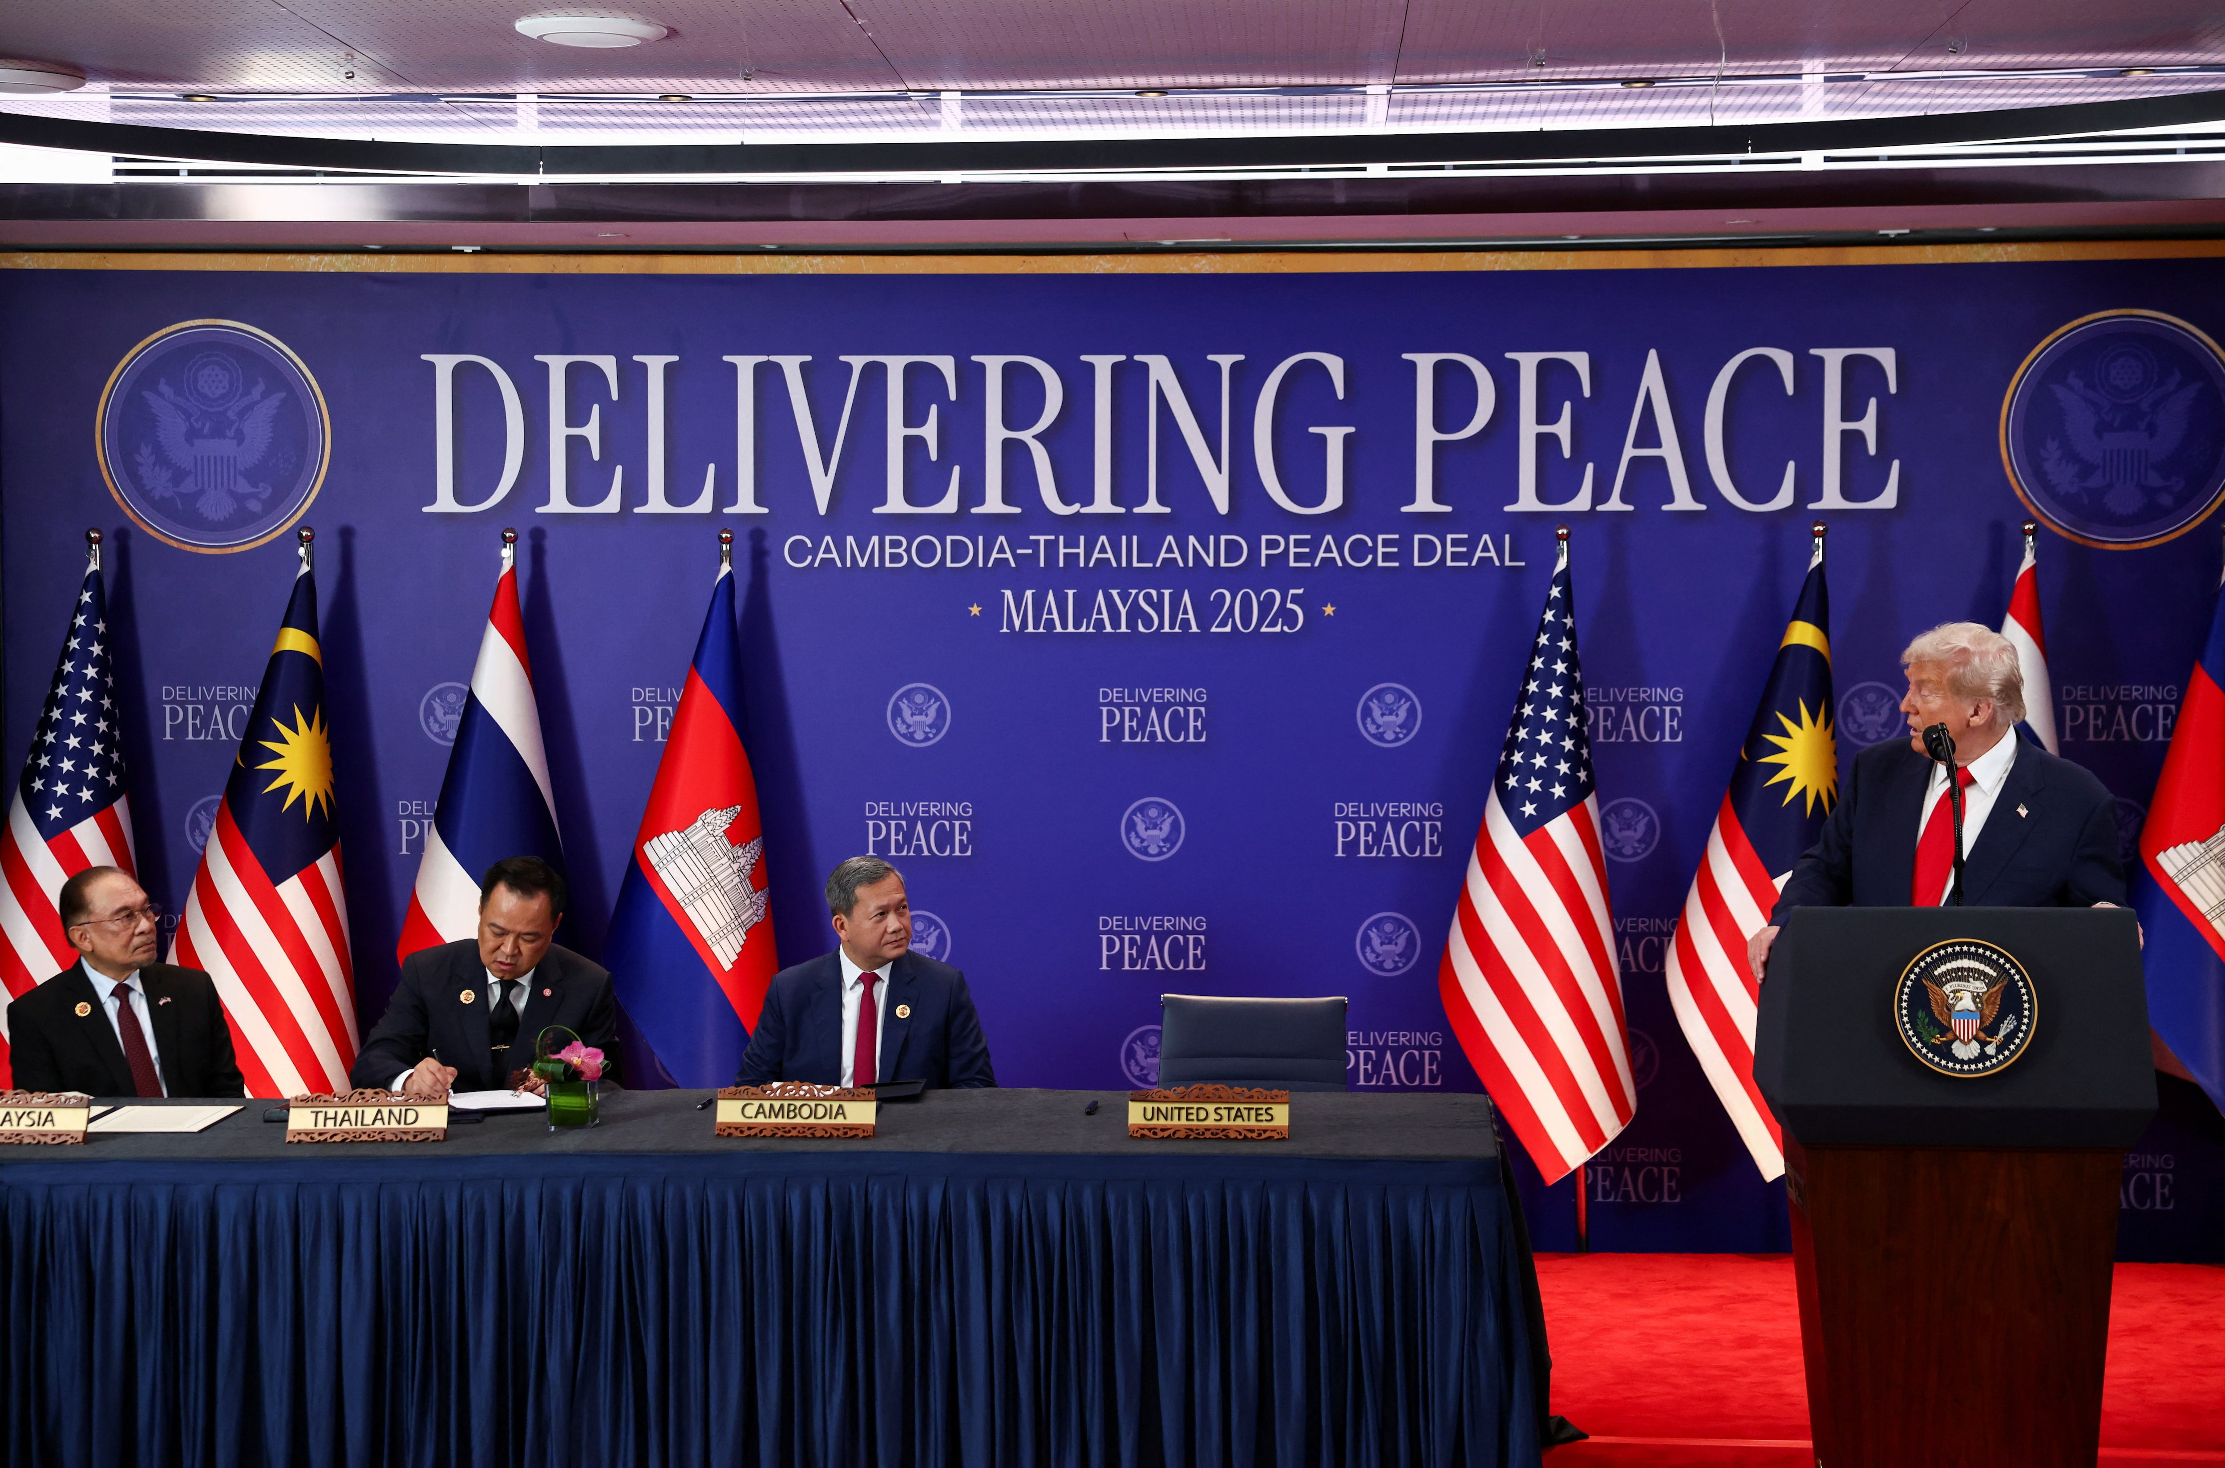
Southeast Asia Trade Deals (ASEAN)
Malaysia (October 26, 2025):
U.S. maintains 19% tariff rate, with selected goods on the PTAAP list cut to 0%
Malaysia committed broad preferential access and acceptance of U.S. standards across broad sectors + no export bans on critical minerals.
Cambodia (October 26, 2025):
U.S. maintains 19% tariff rate, with selected goods on the PTAAP list cut to 0%
Cambodia eliminates tariffs on 100% of U.S. industrial and ag goods and committed to addressing regulatory barriers.
Deal made in conjunction with Cambodia-Thailand ceasefire.
Thailand (October 26, 2025):
U.S. maintains 19% tariff rate, with selected goods on the PTAAP list cut to 0%
Thailand cuts tariffs on 99% of U.S. imports
Thailand commits to agriculture and energy purchases from the U.S. plus 80 U.S. aircraft (~$18.8B)
Vietnam (October 26, 2025):
U.S. maintains 20% tariff rate, with selected goods on the PTAAP list cut to 0%
The U.S. will receive “significant preferential market access” on nearly all goods.

Slide 14
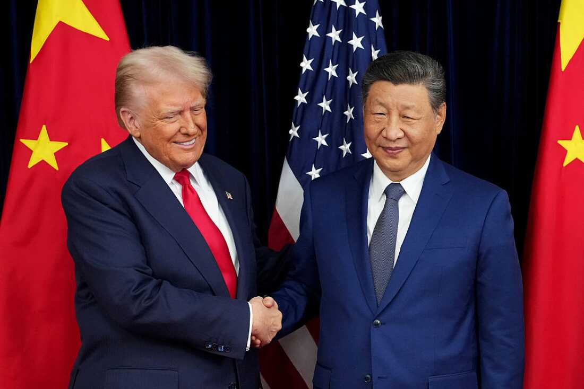
U.S.-China Strategic Dance - From Escalation to Negotiation
The Escalation Phase:
April-May 2025 Escalation: Tariff rates significantly increased during this period, demonstrating administration's willingness to apply maximum pressure
Strategic decision to push China to the negotiating table through economic pressure
The Diplomatic Track:
Geneva Agreement (May 2025): Breakthrough accord to temporarily roll back tariffs and create 90-day window for broader trade deal negotiations
London Talks (June 2025): Continued negotiations focusing on extending tariff truce and addressing complex issues including rare earth exports from China and easing of tech restriction on the U.S. side
Stockholm Round (Late July 2025): Advanced discussions on manufacturing overcapacity and broader tariff framework modifications
Busan Framework (Late October 2025): Deescalation of tariff increases and commitments to control the exports of fentanyl precursors.
Trump-Xi Summit (May 14-15 2026): Trump plans to visit President Xi in May of this year to continue negotiations.
Current Status:
The U.S. announced a one-year suspension of the Section 301 shipbuilding/maritime/logistics probe against Chinese commerce practices.
China announced it will restrict exports of 13 fentanyl precursor chemicals to the U.S., Canada, and Mexico, and suspended its export restrictions on several critical minerals used in semiconductors and military technology.
The IEEPA reciprocal tariffs on China were terminated following the Supreme Court ruling on February 24, 2026. However, the Section 122 global 10% surcharge applies to Chinese goods, and existing Section 301 tariffs from previous administrations remain in effect. New Section 301 investigations launched in March 2026 target China for structural excess manufacturing capacity, which could result in additional tariffs later in 2026.
U.S. President Donald Trump & Chinese President Xi Jinping

Slide 15
Impact on Steel & Pipe Coating
Current Tariff Exposure for Steel & Pipe Coating:
Steel Pipe & Tube (Annex I-A): As of April 6, 2026, imported steel pipe, tubing, and mill products face a 50% tariff on their full customs value under Section 232. This is the highest rate ever applied under the program. Chinese steel also faces stacking Section 301 duties. U.S. domestic steel production has increased in response, but specialty grades and large-diameter pipe remain import-dependent.
Pipe Coating Materials & Equipment:
  Coating resins (epoxy, polyethylene, polyurethane) face the 10% Section 122 global surcharge plus any applicable Section 301 duties.
  Steel coating equipment and machinery classified as derivatives may face 25% tariffs if steel/aluminum content exceeds 15% by weight. Annex III provides a temporary 15% combined cap on certain industrial equipment through Dec 31, 2027.
  Pipeline operators delaying or restructuring capital projects due to tariff cost uncertainty and energy price volatility from the Iran conflict.
  Steel imports declined as 50% tariffs took hold, while domestic mill utilization climbed. Pipe and tube producers are the primary beneficiaries of Section 232 protection.
Industry Outlook for NAPCA Members:
Domestic steel production benefits from 50% tariff wall, but rising energy costs from the Iran conflict are squeezing margins for producers and downstream users alike.
Oil and gas pipeline investment remains strong, but project timelines are extending due to cost uncertainty and permitting delays.

Slide 16
What Comes Next: The Next 6 Months
Section 122 Expiration (July 24): The 10% global surcharge expires in mid-July. Congress is unlikely to extend. The administration is racing to build Section 301 cases as a permanent replacement. Expect significant trade policy turbulence around this deadline.
Section 301 Tariffs Incoming: The USTR's sweeping investigations into 16 economies for excess manufacturing capacity and 60 economies for forced labor could yield new tariffs as early as late summer 2026. Public hearings begin May 5. These tariffs have no cap and no time limit.
IEEPA Refund Fight: The $175 billion refund battle will intensify. CBP is building the CAPE system for automated refunds. Over 2,000 lawsuits pending at CIT. Companies should preserve all duty payment records.
Trade Deals Under Pressure: Countries that negotiated deals under IEEPA tariff duress (EU, Japan, UK, South Korea, ASEAN nations) may slow-walk compliance now that leverage has shifted. The administration will use Section 301 and remaining tools to maintain pressure.
Steel & Pipe Coating Outlook: The April 2026 Section 232 overhaul cements 50% tariffs on steel pipe and tubing at full customs value. Domestic mills are the clear winners. For pipe coaters, higher steel costs and coating material tariffs compress margins. Watch for Iran conflict energy costs to compound these pressures.
USMCA & Buy America: The USMCA review process begins July 1, 2026. Rules of origin for steel could tighten further. Separately, Buy America/Buy American requirements in the Infrastructure Investment and Jobs Act and IRA continue to drive demand for domestically produced and coated pipe.
Section 232 Expansion Continues: Even without IEEPA, Commerce Department investigations into semiconductors, pharmaceuticals, critical minerals, robotics, wind turbines, and medical equipment could yield new Section 232 tariffs at any time.

Slide 17

Thank You
Samir Kapadia
Managing Principal at The Vogel Group
2445 M St. NW, Washington, DC 20037

